Slide 1
Big Data Architektúrák és
Elemző Módszerek 10.EA
Klaszterezés, PCA
Laki Sándor, PhD
Információs Rendszerek Tanszék
ELTE Eötvös Loránd Tudományegyetem
Web: http://lakis.web.elte.hu

Slide 2
Density-Based Clustering Methods
Clustering based on density (local cluster criterion), such as density-connected points
Major features:
  Discover clusters of arbitrary shape
  Handle noise

Slide 3
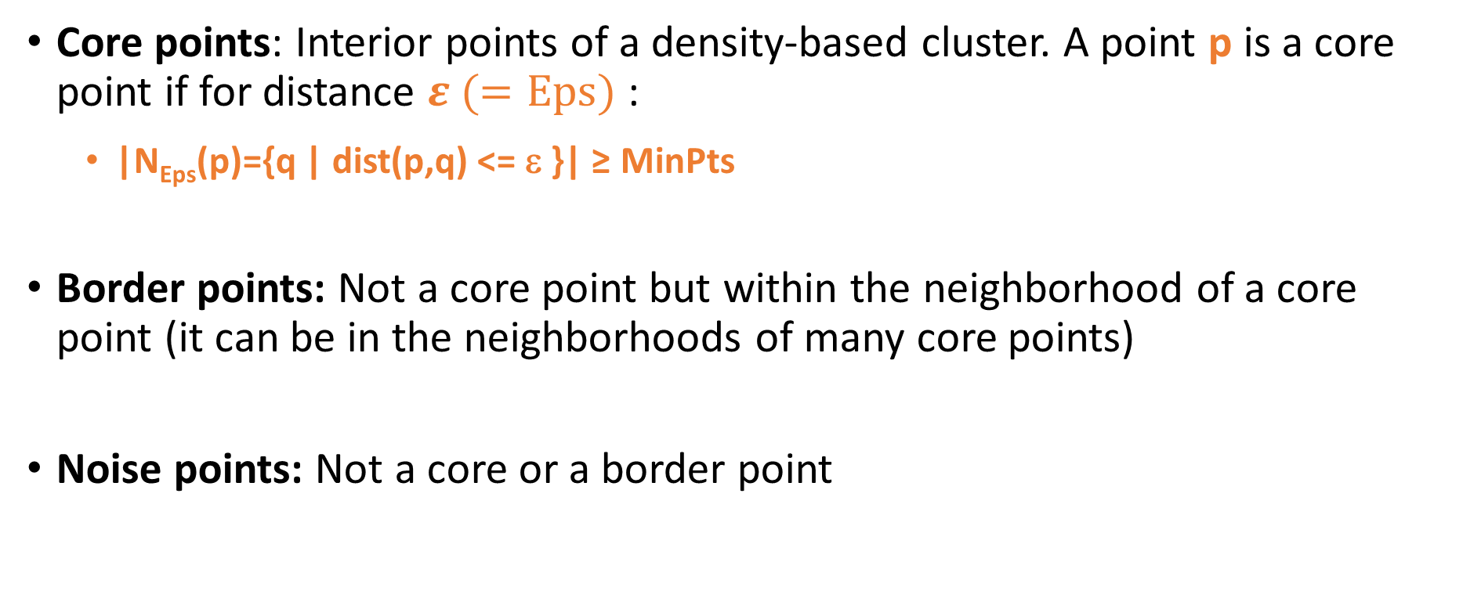
Classification of points in density-based clustering
Core points: Interior points of a density-based cluster. A point p is a core point if for distance $ε (=Eps)$ :
  |N_{Eps}(p)={q | dist(p,q) <= ε }| ≥ MinPts
Border points: Not a core point but within the neighborhood of a core point (it can be in the neighborhoods of many core points)
Noise points: Not a core or a border point

Slide 4
Core, border and noise points
Eps
Eps
Eps

Slide 5
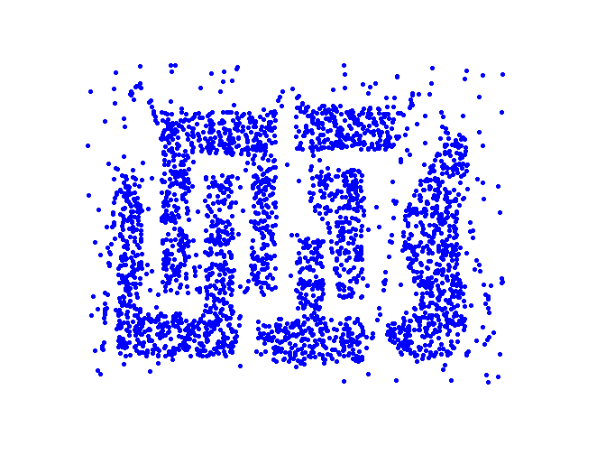
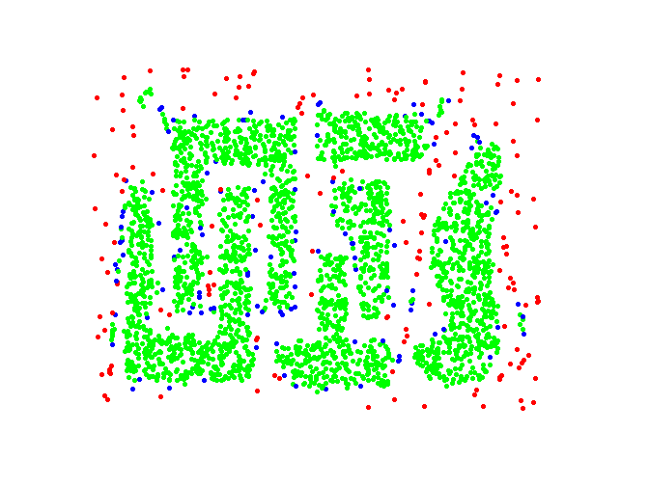
Core, Border and Noise points
Original Points
Point types: core, border and noise
Eps = 10, MinPts = 4

Slide 6
DBSCAN: The Algorithm
  Label all points as core, border, or noise points
  Eliminate noise points
  Put an edge between all core points that are within Eps of each other
  Make each group of connected core points into a separate cluster
  Assign each border point to one of the cluster of its associated core points

Slide 7
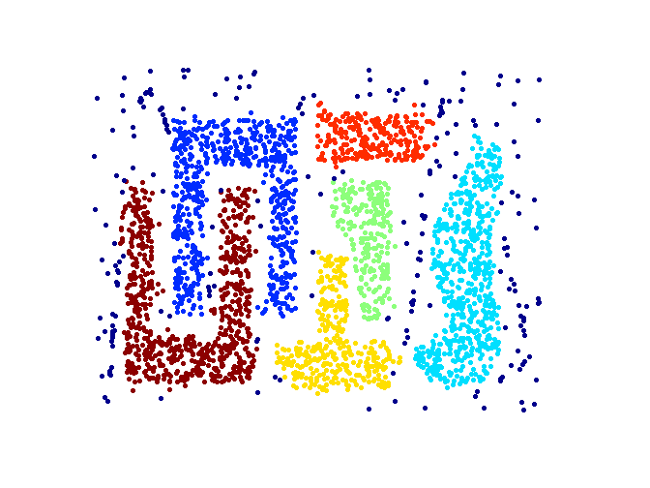
Clusters output by DBScan
Original Points
Clusters
Resistant to Noise
Can handle clusters of different shapes and sizes

Slide 8
Time and space complexity of DBSCAN
For a dataset X consisting of n points, the time complexity of DBSCAN is O(n x time to find points in the Eps-neighborhood)
Worst case O(n²)
In low-dimensional spaces O(nlogn); efficient data structures (e.g., kd-trees) allow for efficient retrieval of all points within a given distance of a specified point

Slide 9
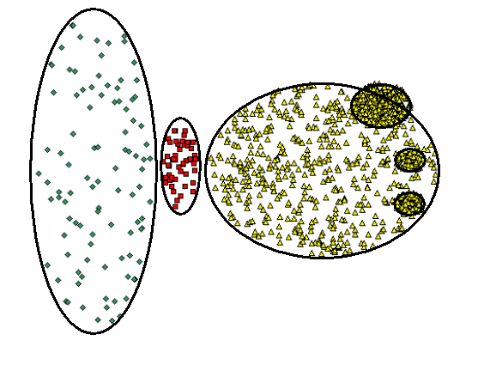
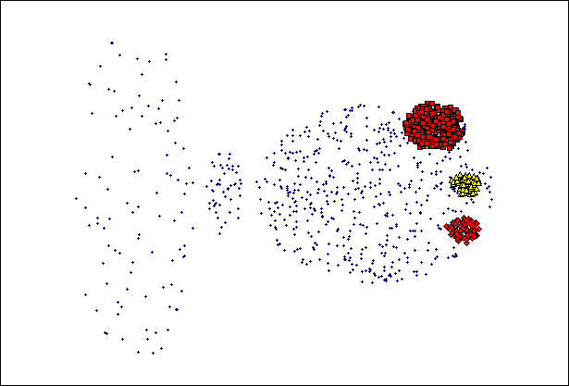
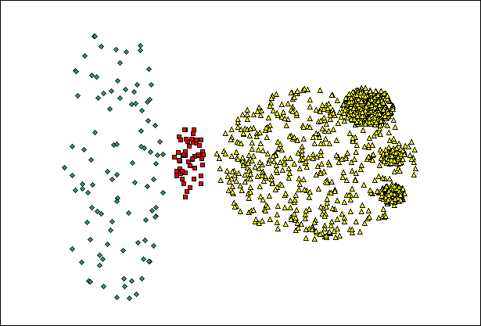
When DBSCAN Does NOT Work Well
(MinPts=4, Eps=9.75).
Original Points
DBScan can fail to identify clusters of varying densities
(MinPts=4, Eps=9.92)

Slide 10
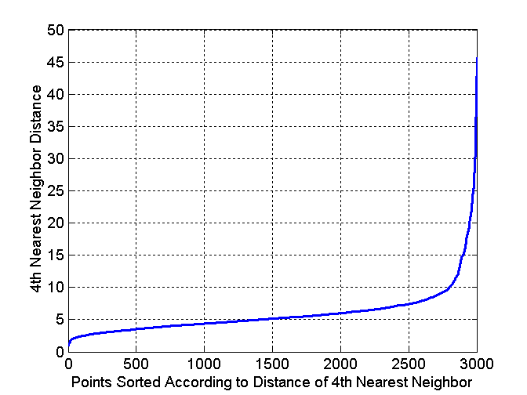
Determining EPS and MinPts
Idea is that for points in a cluster, their k^{th} nearest neighbors are at roughly the same distance
Noise points have the k^{th} nearest neighbor at farther distance
So, plot sorted distance of every point to its k^{th} nearest neighbor

Slide 11
Strengths and weaknesses of DBSCAN
Resistant to noise
Finds clusters of arbitrary shapes and sizes
Difficulty in identifying clusters with varying densities
Problems in high-dimensional spaces; notion of density unclear
Can be computationally expensive when the computation of nearest neighbors is expensive

Slide 12
Unsupervised learning
No training data
  Learning insights and structure from the data itself

Slide 13
Unsupervised learning
No training data
  Learning insights and structure from the data itself
Clustering
Dimension reduction

Slide 14
Motivation
Clustering
  One way to summarize a complex real-valued data point with a single categorical variable
Dimensionality reduction
  Another way to simplify complex high-dimensional data
  Summarize data with a lower dimensional real valued vector

Slide 15
Motivation
Clustering
  One way to summarize a complex real-valued data point with a single categorical variable
Dimensionality reduction
  Another way to simplify complex high-dimensional data
  Summarize data with a lower dimensional real valued vector
Given data points in d dimensions
Convert them to data points in r<d dimensions
With minimal loss of information

Slide 16
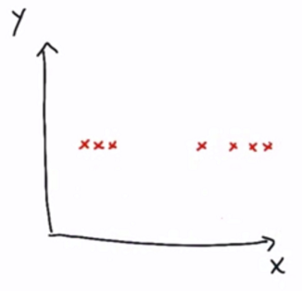
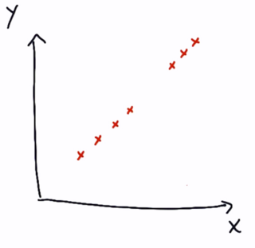
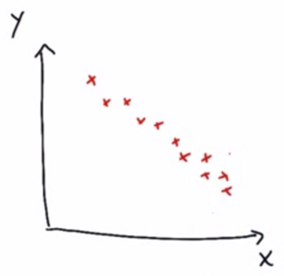
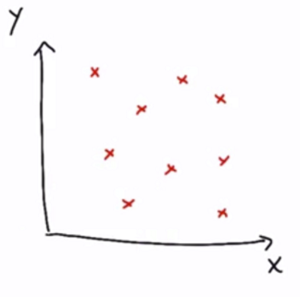
Dimensionality

Slide 17
Dimensionality
1D
1D
1D
2D

Slide 18
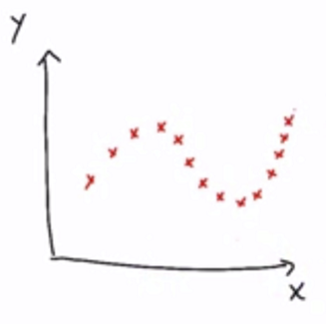
Dimensionality
2D

Slide 19
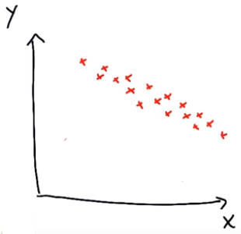
Principal Component Analysis (PCA) in nutshell
New base vectors
  By transitions and rotations only!
Take the centre of the data
a) The principal axis
  the most variations relative to the data points
b) The second principal axis
- less important direction
PCA tells you how important the different axis are.
.

Slide 20
Measurable and latent features
Features of a house are given, what is its price?
Measurable features
Square footage
No. of rooms
School ranking
Neighborhood safety
Latent features
Size
Neighborhood

Slide 21
Measurable and latent features
Features of a house are given, what is its price?
Measurable features
Square footage
No. of rooms
School ranking
Neighborhood safety
Latent features
Size
Neighborhood

Slide 22
Preserving information
Hypothesis: a small number of features actually drives the pattern
Try making a composite feature that more directly probes the undelying phenomenon
  Composite feature – e.g. principle component
Dimension reduction in unsupervised learning

Slide 23
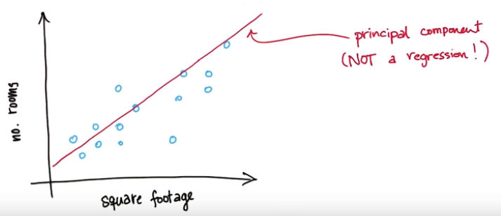
Example: size of a house
Square footage + No. of rooms -> size

Slide 24
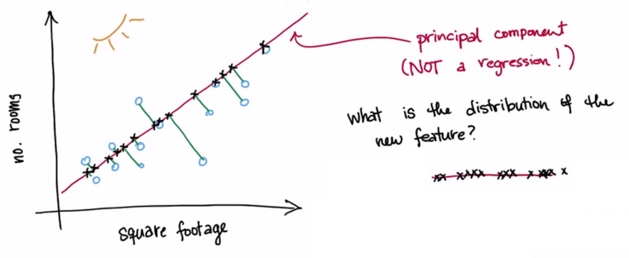
Example: size of a house
Square footage + No. of rooms -> size

Slide 25
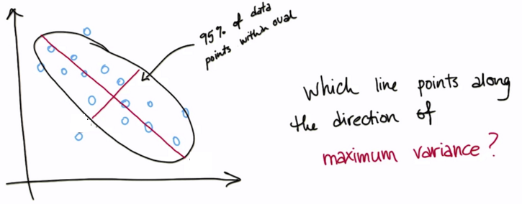
Variance
Roughly the spread of a data distribution
  Similar to std. deviation

Slide 26
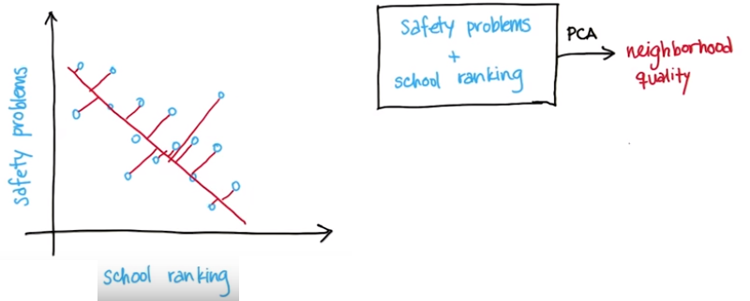
Information loss

Slide 27
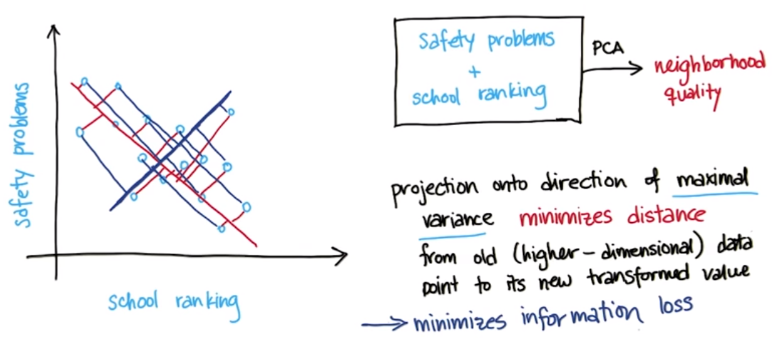
Information loss

Slide 28
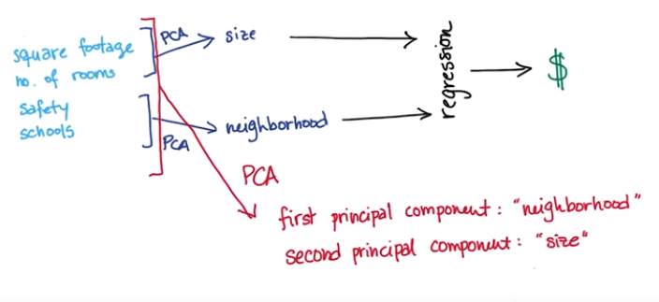
PCA

Slide 29

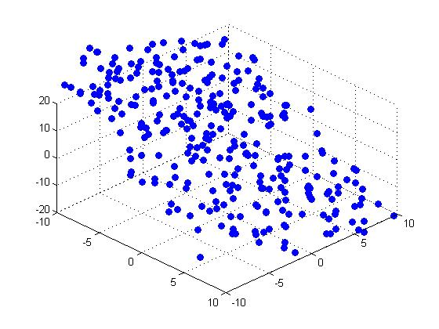





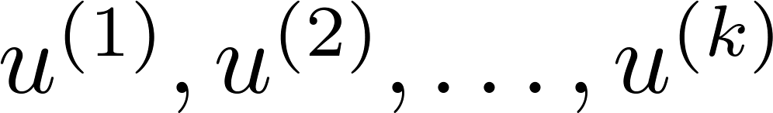
Principal Component Analysis (PCA) problem formulation
Reduce from 2-dimension to 1-dimension: Find a direction (a vector )
onto which to project the data so as to minimize the projection error.
Reduce from n-dimension to k-dimension: Find vectors
onto which to project the data, so as to minimize the projection error.
Andrew Ng
Notes:
Change numbers to LATEX as well

Slide 30
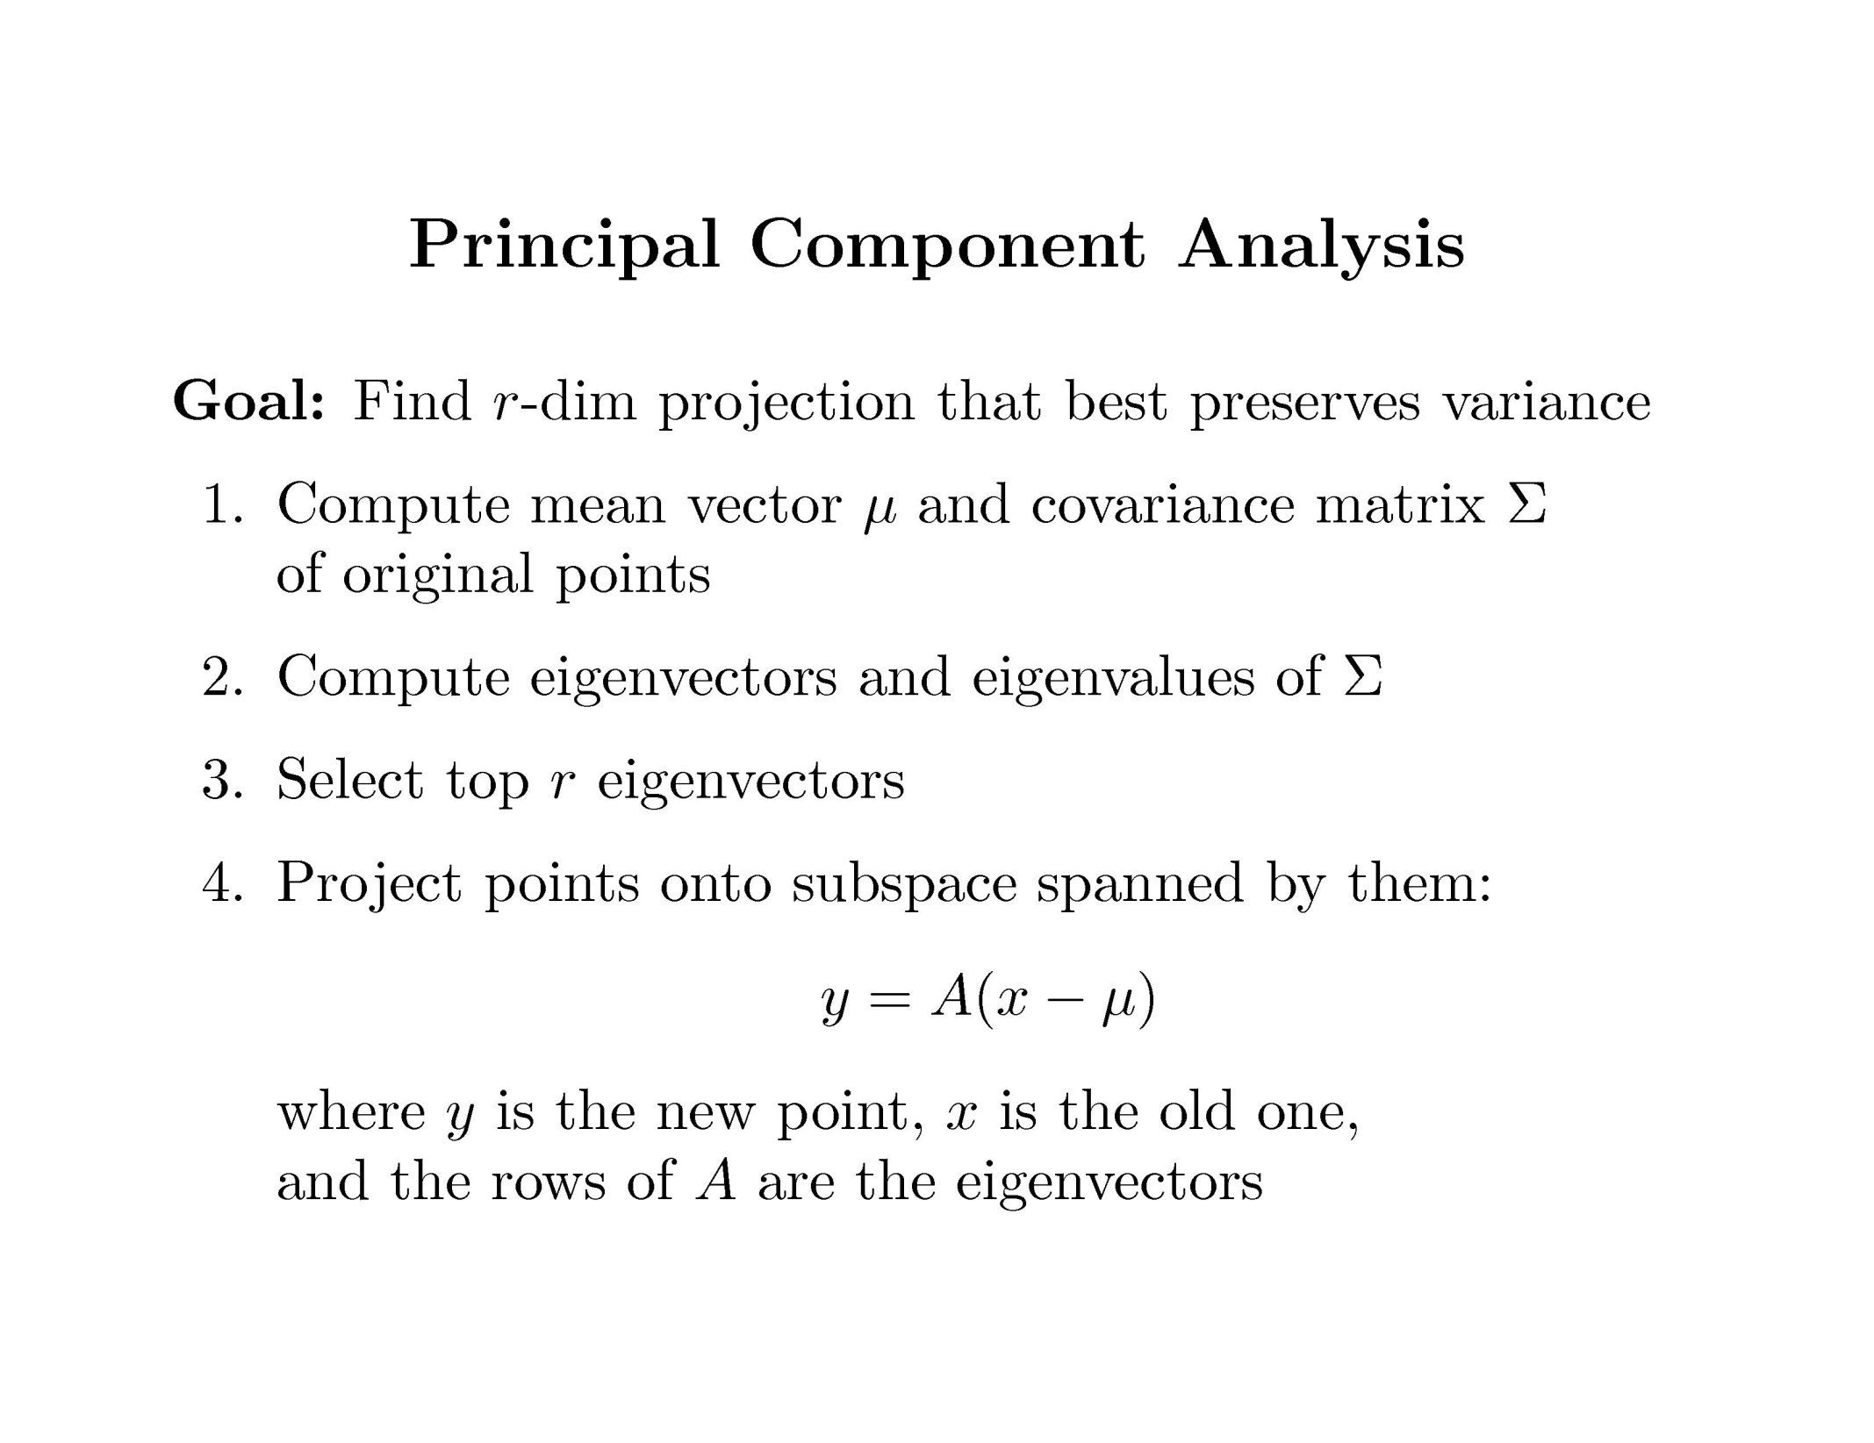

Slide 31
Covariance
Variance and Covariance:
  Measure of the “spread” of a set of points around their center of mass(mean)
Variance:
  Measure of the deviation from the mean for points in one dimension
Covariance:
  Measure of how much each of the dimensions vary from the mean with respect to each other
Covariance is measured between two dimensions
Covariance sees if there is a relation between two dimensions
Covariance between one dimension is the variance

Slide 32
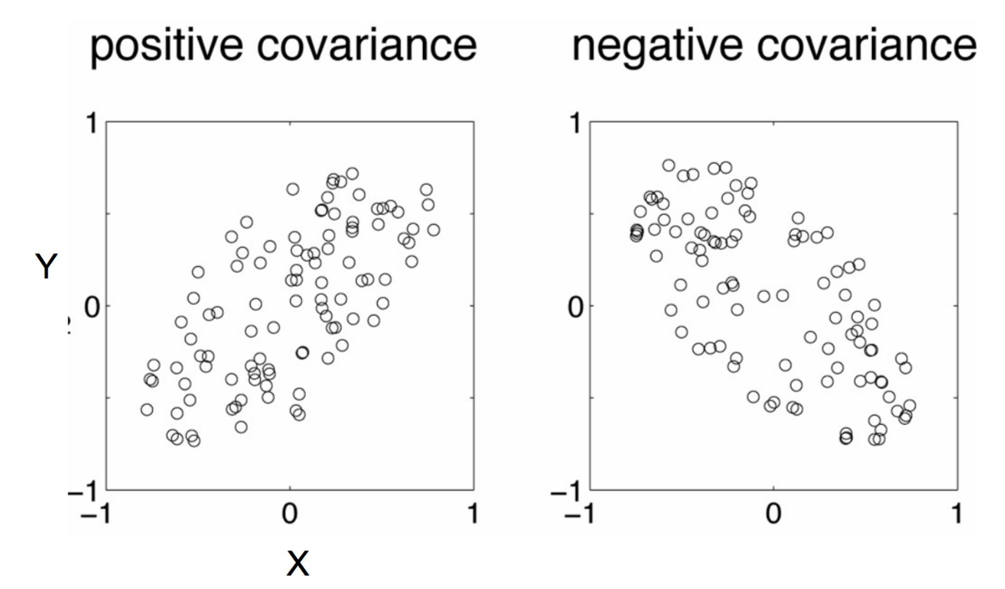
Positive: Both dimensions increase or decrease together
Negative: While one increase the other decrease

Slide 33
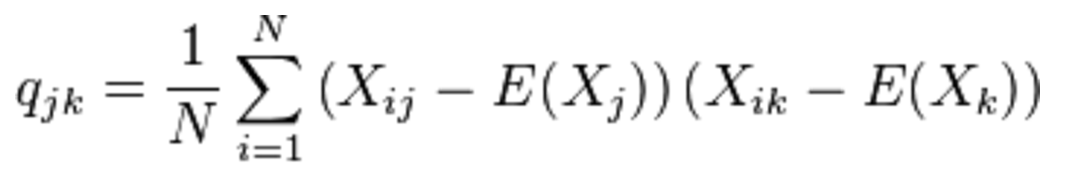
Covariance
Used to find relationships between dimensions in high dimensional data sets
The Sample mean

Slide 34
Eigenvector and Eigenvalue
Ax = λx
A: Square Matrix
x: Eigenvector or characteristic vector
λ : Eigenvalue or characteristic value
The zero vector can not be an eigenvector
The value zero can be eigenvalue

Slide 35
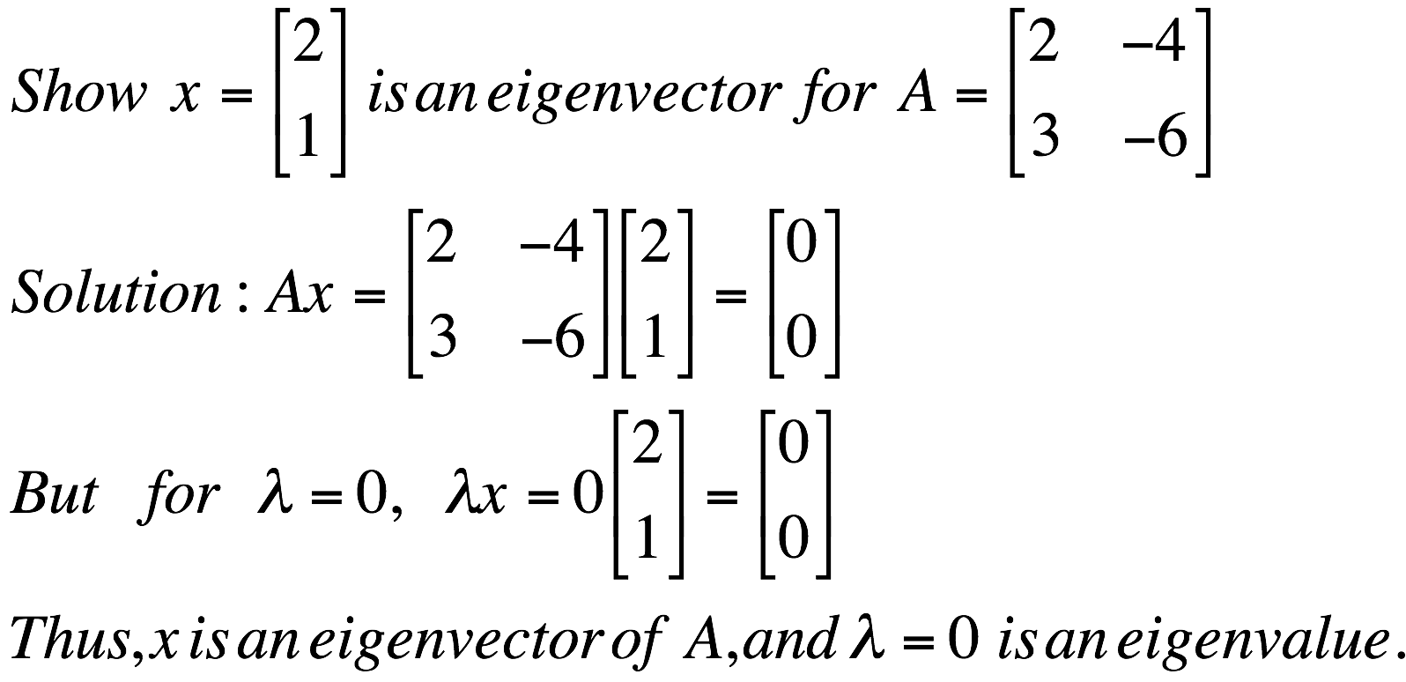
Eigenvector and Eigenvalue
Ax = λx
A: Square Matrix
x: Eigenvector or characteristic vector
λ : Eigenvalue or characteristic value
Example

Slide 36

Eigenvector and Eigenvalue
Ax - λx = 0
(A – λI)x = 0
Ax = λx
B = A – λI
Bx = 0
If we define a new matrix B:
x = B⁻¹0 = 0
BUT! an eigenvector cannot be zero!!
If B has an inverse:
x will be an eigenvector of A if and only if B does not have an inverse, or equivalently det(B)=0 :
det(A – λI) = 0

Slide 37
Eigenvector and Eigenvalue
Example 1: Find the eigenvalues of
two eigenvalues: −1, − 2
Note: The roots of the characteristic equation can be repeated. That is, λ₁ = λ₂ =…= λ_{k}. If that happens, the eigenvalue is said to be of multiplicity k.
Example 2: Find the eigenvalues of
λ = 2 is an eigenvector of multiplicity 3.

Slide 38


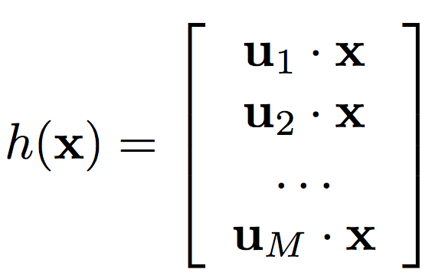

Principal Component Analysis
Input:
Set of basis vectors:
Summarize a D dimensional vector X with K dimensional feature vector h(x)

Slide 39
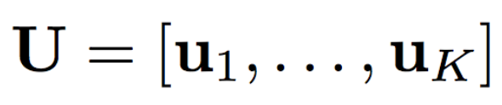
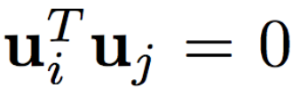
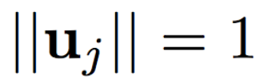

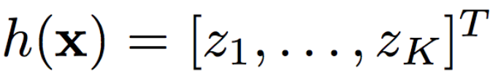
Principal Component Analysis
Basis vectors are orthonormal
New data representation h(x)

Slide 40
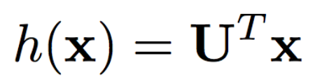
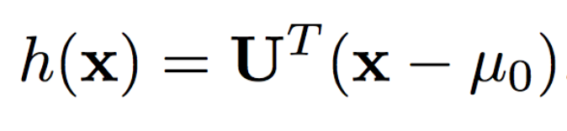
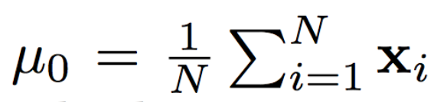
Principal Component Analysis
New data representation h(x)
Empirical mean of the data

Slide 41
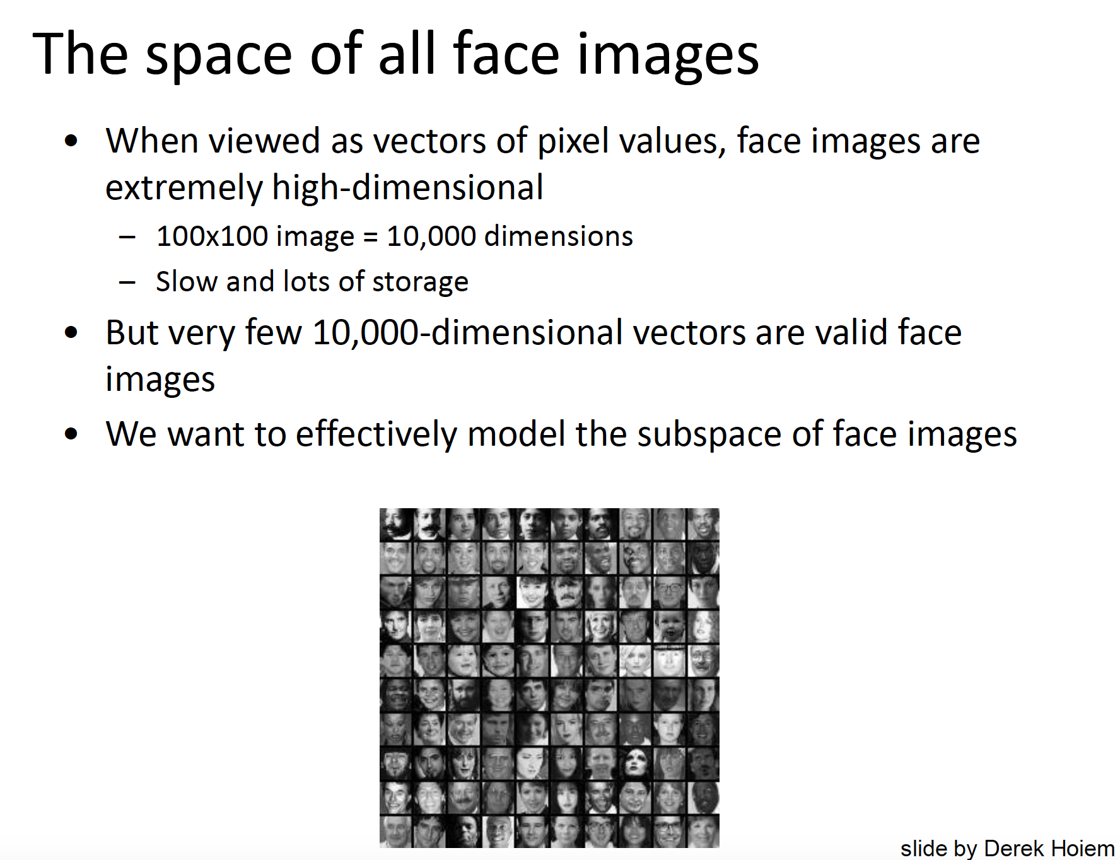

Slide 42
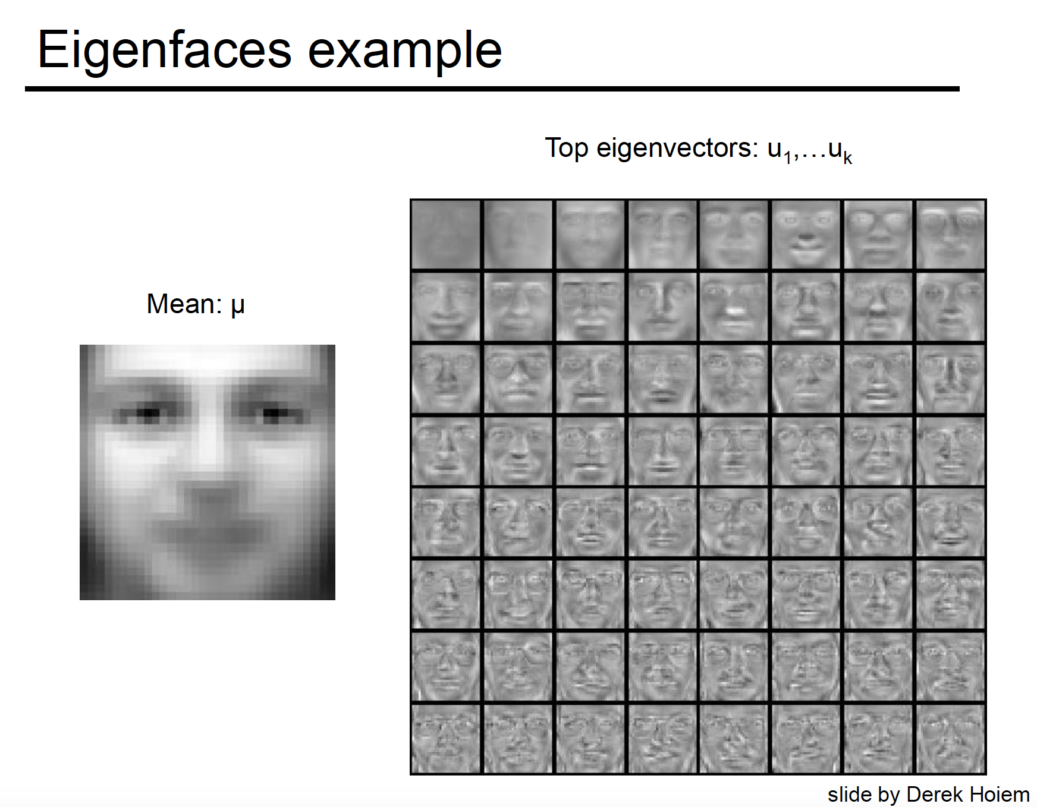

Slide 43
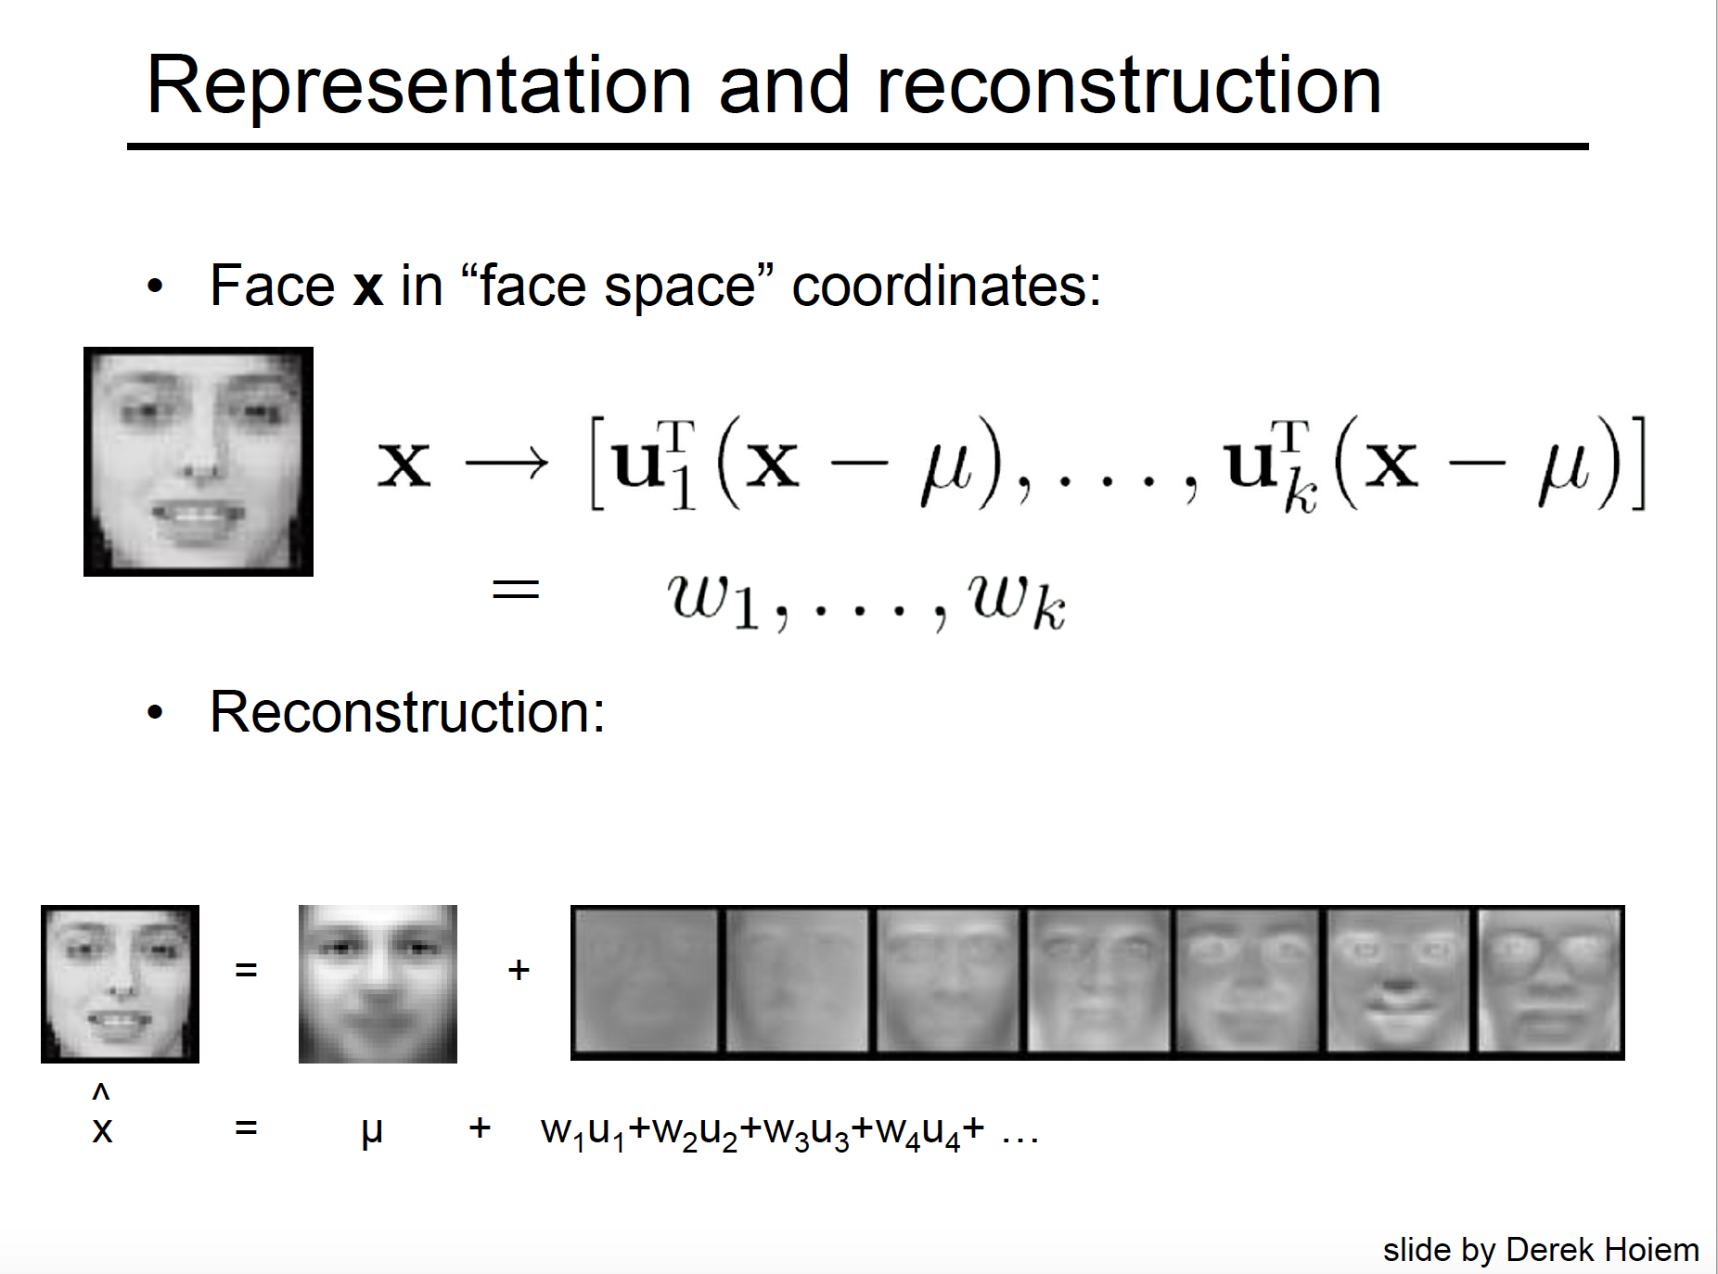

Slide 44
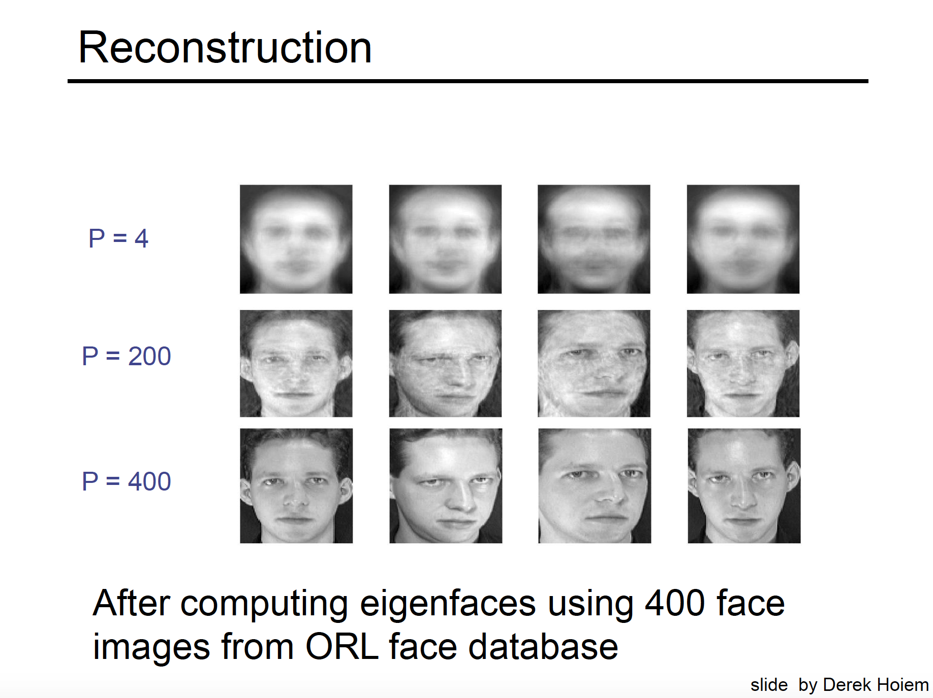
k=4
k=200
k=400

Slide 45

Original Image
Application: Image compression
Divide the original 372x492 image into patches:
  Each patch is an instance that contains 12x12 pixels on a grid
View each as a 144-D vector

Slide 46
Original Image
Application: Image compression
Divide the original 372x492 image into patches:
  Each patch is an instance that contains 12x12 pixels on a grid
View each as a 144-D vector

Slide 47

PCA compression: 144D → 60D

Slide 48

PCA compression: 144D → 16D

Slide 49
16 most important eigenvectors

Slide 50
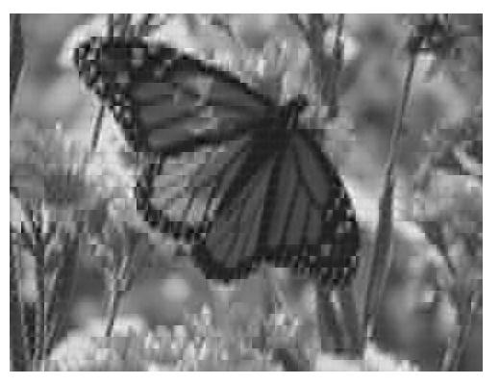
PCA compression: 144D ) 6D

Slide 51
6 most important eigenvectors

Slide 52

PCA compression: 144D → 3D

Slide 53
3 most important eigenvectors

Slide 54
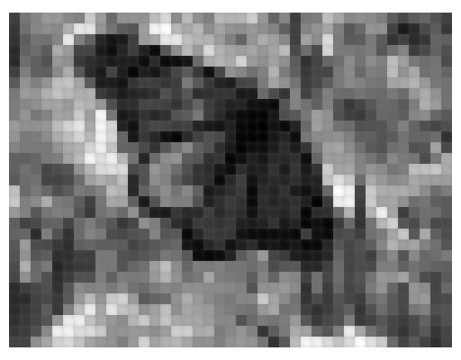
PCA compression: 144D → 1D

Slide 55
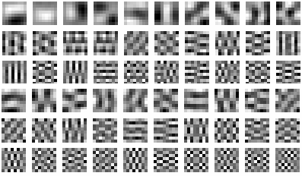
60 most important eigenvectors
Looks like the discrete cosine bases of JPG!...

Slide 56

2D Discrete Cosine Basis
http://en.wikipedia.org/wiki/Discrete_cosine_transform

Slide 57
Dimensionality reduction
PCA (Principal Component Analysis):
  Find projection that maximize the variance
ICA (Independent Component Analysis):
  Very similar to PCA except that it assumes non-Guassian features
Multidimensional Scaling:
  Find projection that best preserves inter-point distances
LDA(Linear Discriminant Analysis):
  Maximizing the component axes for class-separation
…
…

