Slide 1
Big Data Architektúrák és Elemző Módszerek 8.EA Osztályozás – SVM, Naive Bayes, Ensemble methods
Laki Sándor, PhD
Információs Rendszerek Tanszék
ELTE Eötvös Loránd Tudományegyetem
Web: http://lakis.web.elte.hu

Slide 2
Support Vector Machine (SVM)

Slide 3
Reminder: Classification From scatter plot to decision surface
Which one is the best?
Why?
soaring
Intensity
light
Tempo
relaxed
fast

Slide 4
Support Vector Machine
soaring
Intensity
Maximizes distance to the nearest points
called MARGIN
light
Tempo
relaxed
fast

Slide 5
And in this case???
Which line does maximize the margin?
soaring
Intensity
light
Tempo
relaxed
fast

Slide 6
And in this case???
Which line does maximize the margin?
soaring
Intensity
light
Tempo
relaxed
fast

Slide 7
And now???
Which line does maximize the margin?
soaring
Intensity
light
Tempo
relaxed
fast

Slide 8
And now??? Outliers
Which line does maximize the margin?
soaring
Intensity
light
Tempo
relaxed
fast

Slide 9
Will SVM work?
Y
X
X
SVM
Label
Y

Slide 10
And now?
Y
X
X
SVM
Y
Label
X²+Y²

Slide 11
And now?
Z
X
X
SVM
Y
Label
Z=X²+Y²

Slide 12
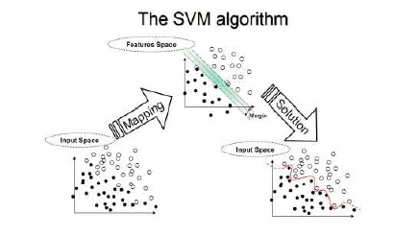
Applying a kernel for transforming the data
X, Y
Not separable
KERNEL
X1, X2, X3, X4, X5…
Separable
NO SOLUTION
No linear separator
SOLUTION
Linearly separable

Slide 13
SVM in sklearn
http://scikit-learn.org/stable/modules/svm.html

Slide 14
Parameters in Machine Learning
Arguments passed when you CREATE your model
Before fitting
After that it does not change
We have seen it for DT
Max. depth
Min. samples, etc.
Criteria: Entropy vs GINI

Slide 15
Parameters for SVM
http://scikit-learn.org/stable/modules/generated/sklearn.svm.SVC.html#sklearn.svm.SVC
Kernel – The kernel function used
Predefined kernels
You can use your own
http://scikit-learn.org/stable/modules/svm.html#svm-kernels
C – penalty parameter
Gamma – Kernel coefficient for some kernels
Proper choice of C and gamma is critical to the SVM’s performance.
Read more about tuning your SVM: https://neerajkumar.org/writings/svm/

Slide 16
Parameter C
Controls tradeoff between smooth decision boundary and classifying training points correctly
Large C = more training points correct
VS

Slide 17
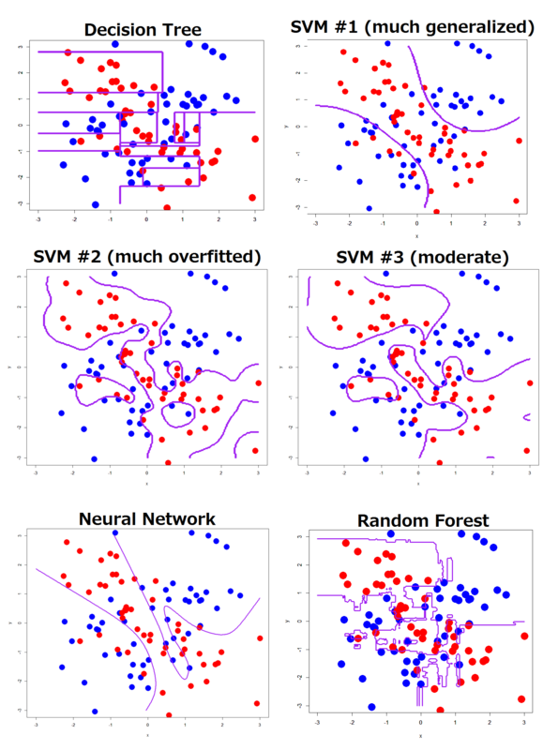
Overfitting
Avoid overfitting!!!
Wrong parameters may lead to overfitting
Both kernel, gamma and C

Slide 18
SVM algorithm
Interested?
Read more about it:
https://www.kdnuggets.com/2020/03/machine-learning-algorithm-svm-explained.html

Slide 19
Naive Bayes

Slide 20
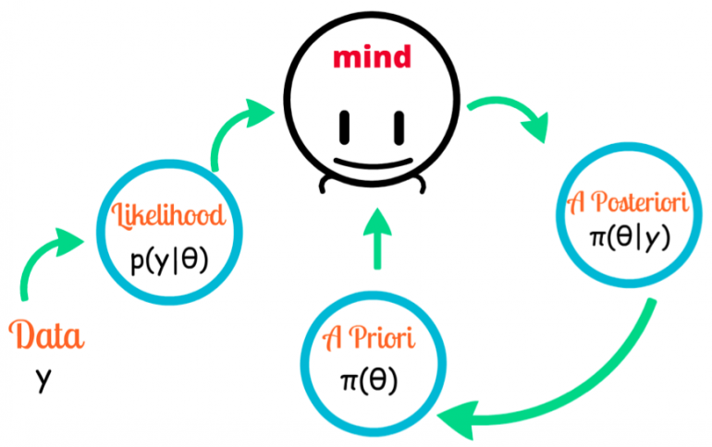
Example
In general:
P( having cancer ) = P(C) = 0.01
There is a new test
90% it is positive if you have C
90% it is negative if you don’t have C
Question:
Test is positive
What is the probability of having C?

Slide 21
Example
C+pos
All people
C
What is the probability that someone with a positive cancer test actually has the disease?
Pos + no C
No C + neg.
Pos
Notes:
8% lesz.
1%-nak van rákja -> az 1% esetén 90%-ban pozitív a teszt => 0.009* minden ember
99%-nak nincs rákja -> 10% esély van hogy pozitív a teszt => 0.099* minden ember
0.099 + 0.009 = 0.108
0.009/0.108 =0.0833 azaz 8%

Slide 22
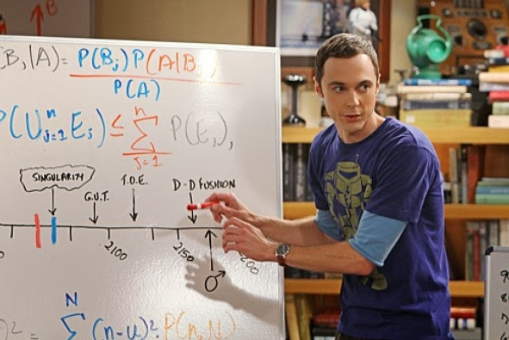
Bayes rule
Prior probability
+
Test evidence
=
Posterior probability

Slide 23
Bayes rule
Prior probability
x
Test evidence
=
Posterior probability

Slide 24
Example
Prior
P(C) = 0.01 and thus P(no C) = 0.99
P(Pos|C) = 0.9
P(Neg|no C) = 0.9 and thus P(Pos|no C) = 0.1
Joint prob.
P(C, Pos) = P(C)*P(Pos|C) = ???
P(no C, Pos) = ???
Normalizer
P(Pos) = P(C, Pos) + P(no C, Pos) = ???
Posterior
P(C|Pos) = P(C,Pos)/P(Pos) = ???
P(no C|Pos) = ???
Notes:
P(C|Pos) = 0.009
P(no C|Pos) = 0.099

Slide 25
Example
Prior
P(C) = 0.01 and thus P(no C) = 0.99
P(Pos|C) = 0.9
P(Neg|no C) = 0.9 and thus P(Pos|no C) = 0.1
Joint prob.
P(C, Pos) = P(C)*P(Pos|C) = 0.01*0.9 = 0.009
P(no C, Pos) = P(no C)*P(Pos|no C) = 0.99*0.1 = 0.099
Normalizer
P(Pos) = P(C, Pos) + P(no C, Pos) = ???
Posterior
P(C|Pos) = P(C,Pos)/P(Pos) = ???
P(no C|Pos) = ???
Notes:
P(C|Pos) = 0.009
P(no C|Pos) = 0.099

Slide 26
Example
Prior
P(C) = 0.01 and thus P(no C) = 0.99
P(Pos|C) = 0.9
P(Neg|no C) = 0.9 and thus P(Pos|no C) = 0.1
Joint prob.
P(C, Pos) = P(C)*P(Pos|C) = 0.01*0.9 = 0.009
P(no C, Pos) = P(no C)*P(Pos|no C) = 0.99*0.1 = 0.099
Normalizer
P(Pos) = ???
Posterior
P(C|Pos) = P(C,Pos)/P(Pos) = ???
P(no C|Pos) = ???
Notes:
P(C|Pos) = 0.009
P(no C|Pos) = 0.099

Slide 27
Example
Prior
P(C) = 0.01 and thus P(no C) = 0.99
P(Pos|C) = 0.9
P(Neg|no C) = 0.9 and thus P(Pos|no C) = 0.1
Joint prob.
P(C, Pos) = P(C)*P(Pos|C) = 0.01*0.9 = 0.009
P(no C, Pos) = P(no C)*P(Pos|no C) = 0.99*0.1 = 0.099
Normalizer
P(Pos) = P(C, Pos) + P(no C, Pos) = 0.108
Posterior
P(C|Pos) = P(C,Pos)/P(Pos) = ???
P(no C|Pos) = ???
Notes:
P(C|Pos) = 0.009
P(no C|Pos) = 0.099

Slide 28
Example
Prior
P(C) = 0.01 and thus P(no C) = 0.99
P(Pos|C) = 0.9
P(Neg|no C) = 0.9 and thus P(Pos|no C) = 0.1
Joint prob.
P(C, Pos) = P(C)*P(Pos|C) = 0.01*0.9 = 0.009
P(no C, Pos) = P(no C)*P(Pos|no C) = 0.99*0.1 = 0.099
Normalizer
P(Pos) = P(C, Pos) + P(no C, Pos) = 0.108
Posterior
P(C|Pos) = ???
P(no C|Pos) = ???
= 1.0
Notes:
P(C|Pos) = 0.009
P(no C|Pos) = 0.099

Slide 29
Example
Prior
P(C) = 0.01 and thus P(no C) = 0.99
P(Pos|C) = 0.9
P(Neg|no C) = 0.9 and thus P(Pos|no C) = 0.1
Joint prob.
P(C, Pos) = P(C)*P(Pos|C) = 0.01*0.9 = 0.009
P(no C, Pos) = P(no C)*P(Pos|no C) = 0.99*0.1 = 0.099
Normalizer
P(Pos) = P(C, Pos) + P(no C, Pos) = 0.108
Posterior
P(C|Pos) = P(C,Pos)/P(Pos) = 0.08
P(no C|Pos) = 0.92
= 1.0
Notes:
P(C|Pos) = 0.009
P(no C|Pos) = 0.099

Slide 30
Example
Prior
P(C) = 0.01 and thus P(no C) = 0.99
P(Pos|C) = 0.9
P(Neg|no C) = 0.9 and thus P(Pos|no C) = 0.1
Joint prob.
P(C, Pos) = P(C)*P(Pos|C) = ???
P(no C, Pos) = P(no C)*P(Pos|no C) = ???
Normalizer
P(Pos) = P(C, Pos) + P(no C, Pos) = ???
Posterior
P(C|Pos) = P(C,Pos)/P(Pos) = ???
P(no C|Pos) = ???
= 1.0
Notes:
P(C|Pos) = 0.009
P(no C|Pos) = 0.099

Slide 31
Bayes rule

Slide 32
Bayes rule for classification
Text learning
P(Bob)=P(Jen)=0.5
Bob
Jen
0.1
0.1
0.5
0.2
0.3
0.8
LOVE
LIFE
LOVE
LIFE
DEAL
DEAL
Who said: Love life!

Slide 33
Bayes rule for classification
Text learning
P(Bob)=P(Jen)=0.5
Bob
Jen
0.1
0.1
0.5
0.2
0.3
0.8
LOVE
LIFE
LOVE
LIFE
DEAL
DEAL
Who said: Love life!
Jen

Slide 34
Bayes rule for classification
Text learning
P(Bob)=P(Jen)=0.5
Bob
Jen
0.1
0.1
0.5
0.2
0.3
0.8
LOVE
LIFE
LOVE
LIFE
DEAL
DEAL
LIFE DEAL
Bob: 0.1*0.8*0.5 = 0.04
Jen: 0.3*0.2*0.5 = 0.03

Slide 35
Bayes rule for classification
Text learning
P(Bob)=P(Jen)=0.5
Bob
Jen
0.1
0.1
0.5
0.2
0.3
0.8
LOVE
LIFE
LOVE
LIFE
DEAL
DEAL
LIFE DEAL
Bob: 0.1*0.8*0.5 = 0.04
Jen: 0.3*0.2*0.5 = 0.03
P(Bob | „LIFE DEAL”) = ???
P(Jen | „LIFE DEAL”) = ???

Slide 36
Bayes rule for classification
Text learning
P(Bob)=P(Jen)=0.5
Bob
Jen
0.1
0.1
0.5
0.2
0.3
0.8
LOVE
LIFE
LOVE
LIFE
DEAL
DEAL
LIFE DEAL
Bob: 0.1*0.8*0.5 = 0.04
Jen: 0.3*0.2*0.5 = 0.03
P(Bob | „LIFE DEAL”) = P(Bob)*P(„LIFE DEAL” | Bob)/P(„LIFE DEAL”)=0.5*0.1*0.8/(0.04+0.03)
P(Jen | „LIFE DEAL”) = P(Jen)*P(„LIFE DEAL” | Jen)/P(„LIFE DEAL”)=0.5*0.3*0.2/(0.04+0.03)

Slide 37
Why naive?
Words are taken into account
What about word order and text length?
These are not handled at all by the model…

Slide 38
Naive bayes in scikit learn
In general:
http://scikit-learn.org/stable/modules/naive_bayes.html
Gaussian Naive Bayes
http://scikit-learn.org/stable/modules/generated/sklearn.naive_bayes.GaussianNB.html#sklearn.naive_bayes.GaussianNB

Slide 39
Text representation

Slide 40
How to represent texts???
Bag of words
Dictionary
Bag of words
Nice
Very
Day
He
She
Love
Dog
1
0
1
0
0
0
0
1
2
1
0
0
0
0
1
0
2
0
0
1
0
Nice day
A very very nice day
Mr Day loves a nice day

Slide 41
Bag of words in sklearn
From sklearn.feature_extraction.text import CountVectorizer
vectorizer = CountVectorizer()
text = [string1, string2, …, stringN]
bag_of_words = vectorizer.fit_transform(text)
Check how it work!!!

Slide 42
Not all words are equally important
Some words contain more information than others
The, will, are, is, a, an, …
Day, love, like, physics, …
Stopwords – unimportant words that only carry minimal information
should be removed from the text
E.g. the, in, for, you, will, have, be, …
In python, use nltk package:
from nltk.corpus import stopwords
stop = stopwords.words('english')

Slide 43
Unique or not unique
The same word can be used in different forms
Stemmers apply a stemming function on all the words
Unresponsive
Response
Responsiveness
Responsivity
Respond
STEMMER
Respon

Slide 44
Stemming in python
Use NLTK package
Natural Language Processing ToolKit
http://www.nltk.org/howto/stem.html
from nltk.stem.snowball import SnowballStemmer
stemmer = SnowballStemmer(„english”)
stemmer.stem(„responsiveness”)
# will return repons
stemmer.stem(„responsivity”)
# will return respons
stemmer.stem(„unresponsive”)
# will return unrespons

Slide 45
Order of operations
1. stemming
2. removing stopwords
3. Text represenation
Bag-of-words
TfIdf

Slide 46
Representation
Rate words are more important than common ones
How to express this?
Upweight rare words
TF – term frequency
Like bag of words
e.g. word frequency in a document
IDF – inverse document frequency
Weighting by how often word occurs in the corpus
$IDF\left(t,D\right)=log\frac{|D|}{|\{ d in D:t in d\}|}$

Slide 47
TF-IDF representation
$tfidf\left(t,d,D\right)=TF\left(t,d\right)×IDF\left(t,D\right)$
t: the word
d: the given document
D: collection of documents, corpus
In sklearn:
Use TfidfVectorizer!!!
http://scikit-learn.org/stable/modules/feature_extraction.html#text-feature-extraction
from sklearn.feature_extraction.text import TfidfVectorizer
vectorizer = TfidfVectorizer(min_df=1)
vectorizer.fit_transform(corpus)

Slide 48
More about text representation
Interested?
A gentle introduction
https://towardsdatascience.com/introduction-to-text-representations-for-language-processing-part-1-dc6e8068b8a4
Text classification
https://monkeylearn.com/text-classification/
Deep learning for text representation
https://medium.com/analytics-vidhya/deep-learning-techniques-for-text-representation-part-1-75c4ad4aa133

Slide 49
Ensemble methods

Slide 50
The ensemble concept
Build multiple models based on
Different training data
Different learning algorithms
Combine decisions of multiple models
E.g. using weighted voting
Training Data
⋅ ⋅ ⋅ ⋅ ⋅ ⋅ ⋅ ⋅
Data1
Data2
Data m
Learner1
Learner2
⋅ ⋅ ⋅ ⋅ ⋅ ⋅ ⋅ ⋅
Learner m
⋅ ⋅ ⋅ ⋅ ⋅ ⋅ ⋅ ⋅
Model1
Model2
Model m
Model Combiner
Final Model

Slide 51
Idea
Combining multiple independent and diverse decisions
Each of them is at least more accurace than random guessing
Random errors cancel each other out
Correct decisions are reinforced
Real life examples
How many jelly beans in the jar?
Individual guess vs group average
Who Wants to be a Millionaire
Expert friend vs audience vote

Slide 52
Homogenous case
Single learning algorithm trained on multiple training data
Data1 ≠ Data2 ≠ … ≠ Data m
Learner1 = Learner2 = … = Learner_m
Different methods for changind training data
Bagging: Resample training data - replicates
Boosting: Reweight training data
Decorate: Add artificial training data

Slide 53
Bagging
Ensembles by randomly resampling the training data (Brieman, 1996)
Given a training set of size n
Create m samples of size n by taking n examples from the original data with replacement
Combine the m resulting models
by majority vote
Decreases error by decresing the variance in the results of unstable learners like DTs

Slide 54
Bagging
Sampling with replacement
Build a classifier on each bootstrap sample
Each example has probability 1/N being selected
For an example not being selected after N times, the probability is (1 – 1/N)^{N} (when N is large, it is close to 1/e)
For an example being selected after N times, the probability is 1 – 1/e = 0.632
A bootstrap sample contains 63% of the original data

Slide 55
Boosting
An iterative procedure to adaptively change distribution of training data by focusing more on previously misclassified records
Initially, all N records are assigned equal weights
Unlike bagging, weights may change at the end of boosting round
The weigth of wrongly classified samples is increased
While for the correctly classified samples it is decreased

Slide 56
Boosting
Records that are wrongly classified will have their weights increased
Records that are classified correctly will have their weights decreased
Example 4 is hard to classify
Its weight is increased, therefore it is more likely to be chosen again in subsequent rounds

Slide 57
Example: AdaBoost
Base classifiers: C₁, C₂, …, C_{T}
Error rate:
Importance of a classifier:

Slide 58
Example: AdaBoost
Weight update:
Classification:

Slide 59
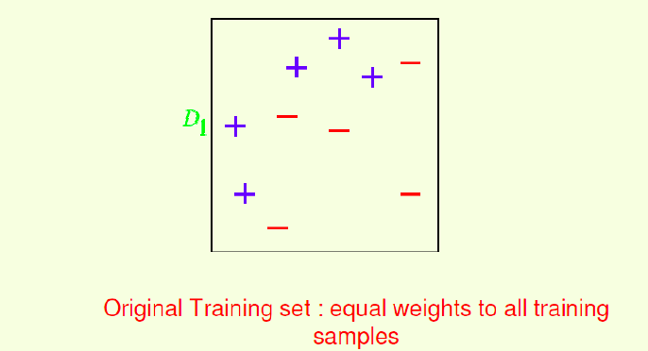
AdaBoost example

Slide 60
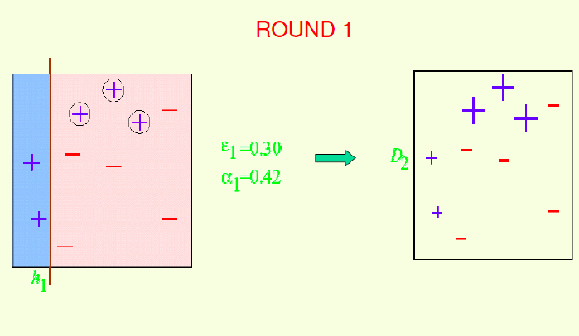
AdaBoost example

Slide 61
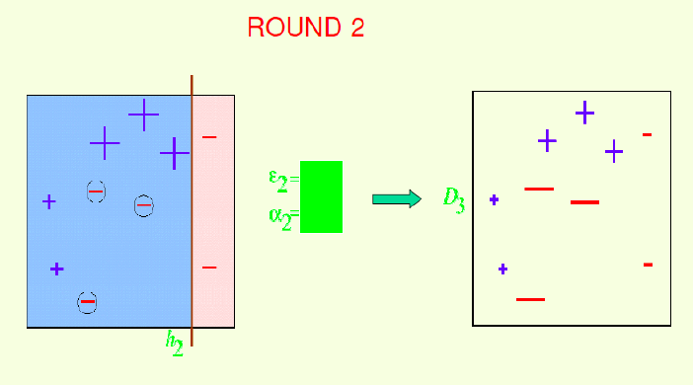
AdaBoost example
Compute the two values and the weight of the instances in Round 2
Notes:
E2=0.214
A2=0.65

Slide 62
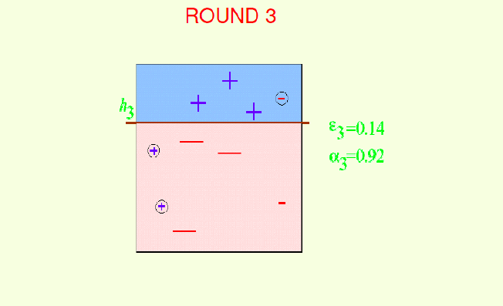
AdaBoost example

Slide 63
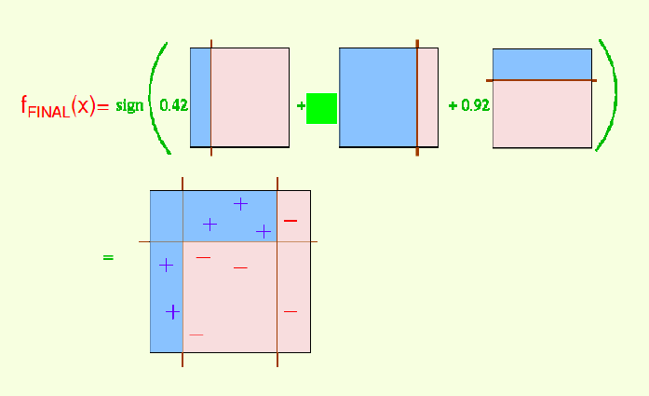
AdaBoost example
Notes:
A2=0.65

Slide 64
Illustrating AdaBoost
Initial weights for each data point
Data points for training

Slide 65
Illustrating AdaBoost

Slide 66
How strong an AdaBoost classifier?
The training set error decreases exponentially with the number of Adaboost iterations T. Therefore, we can make the training set error arbitrarily small by running more iterations.
The generalization error (error on the parent distribution) decreases with the square root of the size of the training set. Therefore, we can make the generalization error arbitrarily small by increasing the size of the training set.

Slide 67
More readings
AdaBoost explained
https://towardsdatascience.com/adaboost-intuition-and-explanation-9c4e67034879
Or more deeply
https://www.cs.princeton.edu/courses/archive/spring18/cos511/scribe_notes/0312.pdf

Slide 68
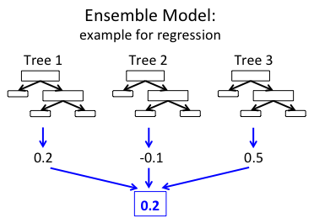
GradientBoostingTree
The idea is similar to AdaBoost…

