Slide 1
Big Data Architektúrák és
Elemző Módszerek 9.EA
Ensemble módszerek
Klaszterezés – K-Means
Laki Sándor, PhD
Információs Rendszerek Tanszék
ELTE Eötvös Loránd Tudományegyetem
Web: http://lakis.web.elte.hu

Slide 2
Ensemble methods

Slide 3
The ensemble concept
Build multiple models based on
  Different training data
  Different learning algorithms
Combine decisions of multiple models
  E.g. using weighted voting
Training Data
⋅ ⋅ ⋅ ⋅ ⋅ ⋅ ⋅ ⋅
Data1
Data2
Data m
Learner1
Learner2
⋅ ⋅ ⋅ ⋅ ⋅ ⋅ ⋅ ⋅
Learner m
⋅ ⋅ ⋅ ⋅ ⋅ ⋅ ⋅ ⋅
Model1
Model2
Model m
Model Combiner
Final Model

Slide 4

Idea
Combining multiple independent and diverse decisions
  Each of them is at least more accurace than random guessing
Random errors cancel each other out
  Correct decisions are reinforced
Real life examples
  How many jelly beans in the jar?
    Individual guess vs group average
  Who Wants to be a Millionaire
    Expert friend vs audience vote

Slide 5
Homogenous case
Single learning algorithm trained on multiple training data
  Data1 ≠ Data2 ≠ … ≠ Data m
  Learner1 = Learner2 = … = Learner_m
Different methods for changind training data
  Bagging: Resample training data - replicates
  Boosting: Reweight training data
  Decorate: Add artificial training data

Slide 6
Bagging
Ensembles by randomly resampling the training data (Brieman, 1996)
Given a training set of size n
  Create m samples of size n by taking n examples from the original data with replacement
Combine the m resulting models
  by majority vote
Decreases error by decresing the variance in the results of unstable learners like DTs

Slide 7
Bagging
Sampling with replacement
Build a classifier on each bootstrap sample
Each example has probability 1/N being selected
For an example not being selected after N times, the probability is (1 – 1/N)^{N} (when N is large, it is close to 1/e)
For an example being selected after N times, the probability is 1 – 1/e = 0.632
A bootstrap sample contains 63% of the original data

Slide 8
Boosting
An iterative procedure to adaptively change distribution of training data by focusing more on previously misclassified records
  Initially, all N records are assigned equal weights
  Unlike bagging, weights may change at the end of boosting round
    The weigth of wrongly classified samples is increased
    While for the correctly classified samples it is decreased

Slide 9
Boosting
Records that are wrongly classified will have their weights increased
Records that are classified correctly will have their weights decreased
Example 4 is hard to classify
Its weight is increased, therefore it is more likely to be chosen again in subsequent rounds

Slide 10
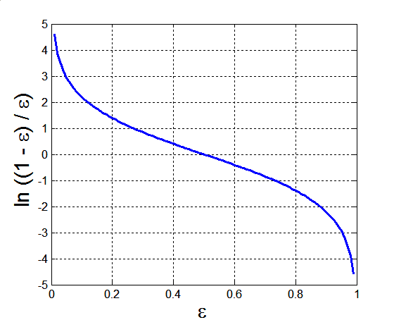
Example: AdaBoost
Base classifiers: C₁, C₂, …, C_{T}
Error rate:
Importance of a classifier:

Slide 11
Example: AdaBoost
Weight update:
Classification:

Slide 12
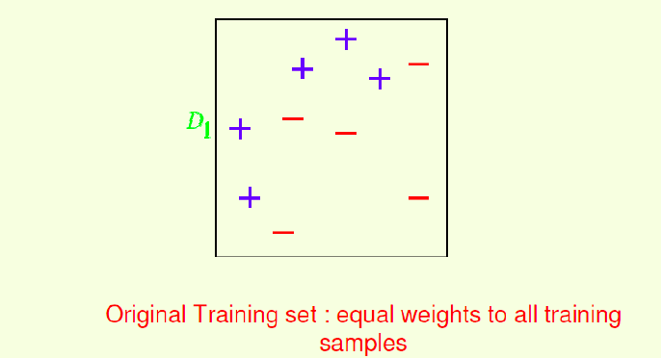
AdaBoost example

Slide 13
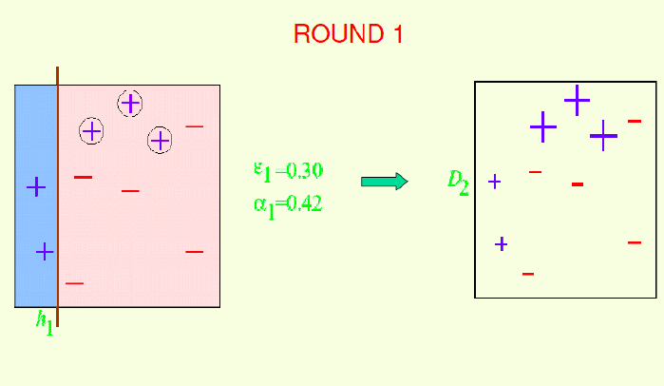
AdaBoost example

Slide 14
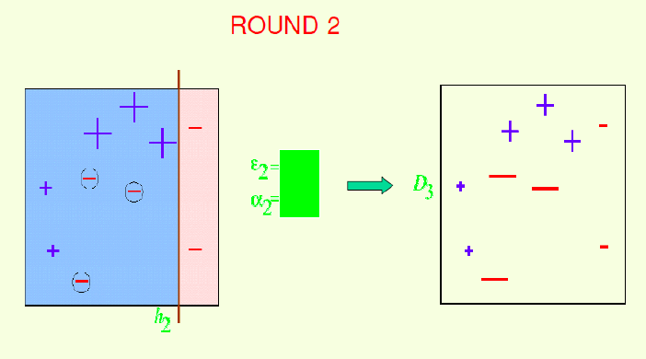
AdaBoost example
Compute the two values and the weight of the instances in Round 2
Notes:
E2=0.214
A2=0.65

Slide 15
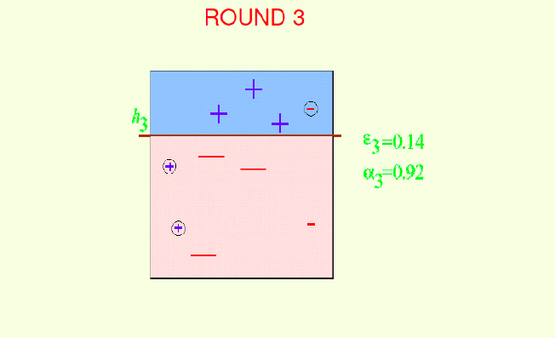
AdaBoost example

Slide 16
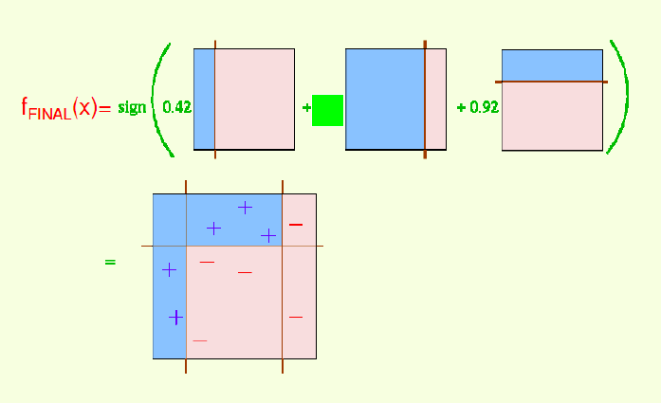
AdaBoost example
Notes:
A2=0.65

Slide 17
Illustrating AdaBoost
Initial weights for each data point
Data points for training

Slide 18
Illustrating AdaBoost

Slide 19
How strong an AdaBoost classifier?
The training set error decreases exponentially with the number of Adaboost iterations T. Therefore, we can make the training set error arbitrarily small by running more iterations.
The generalization error (error on the parent distribution) decreases with the square root of the size of the training set. Therefore, we can make the generalization error arbitrarily small by increasing the size of the training set.

Slide 20
More readings
AdaBoost explained
  https://towardsdatascience.com/adaboost-intuition-and-explanation-9c4e67034879
Or more deeply
  https://www.cs.princeton.edu/courses/archive/spring18/cos511/scribe_notes/0312.pdf

Slide 21
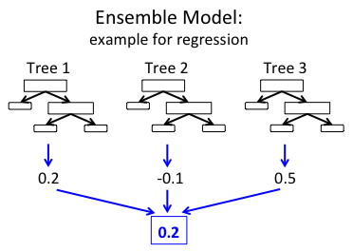
GradientBoostingTree
The idea is similar to AdaBoost…

Slide 22
Clustering

Slide 23
Unsupervised learning
No training data
  Learning insights and structure from the data itself

Slide 24
Unsupervised learning
No training data
  Learning insights and structure from the data itself
Clustering
Dimension reduction

Slide 25
Why cluster?
Labeling is expensive
Gain insight into the structure of the data
Find prototypes in the data
Notes:
Until now we have assumed that the training data is labeled.
Now we look at what can we do with data when we have not labels.
\item Example: group customer behavior, find similar buying patterns.

Slide 26
Goal of Clustering
Given a set of data points, each described by a set of attributes, find clusters such that:
  Inter-cluster similarity is
  maximized
  Intra-cluster similarity is
  minimized
Requires the definition of a similarity measure
F1
x
x
x
x
x
x
x
x
xx
x
x
x
x
x
x
xx
x
F2
Notes:
Data

Slide 27
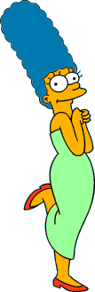



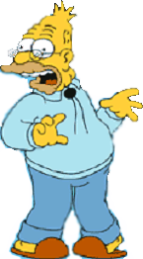
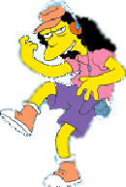



What is a natural grouping of these objects?
Slide from Eamonn Keogh

Slide 28



What is a natural grouping of these objects?
Slide from Eamonn Keogh
Clustering is subjective
Simpson's Family
School Employees
Females
Males

Slide 29
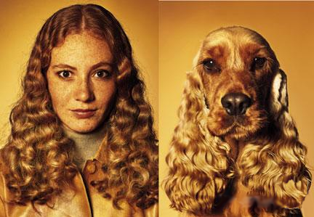
What is Similarity?
Slide based on one by Eamonn Keogh
Similarity is hard to define, but…
“We know it when we see it”

Slide 30
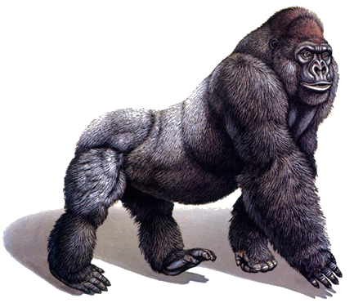
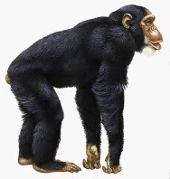
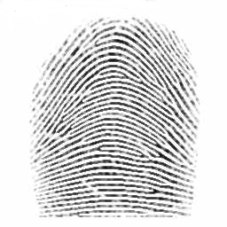
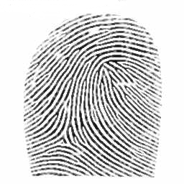
Defining Distance Measures
Slide from Eamonn Keogh
Definition: Let O₁ and O₂ be two objects from the universe of possible objects. The distance (dissimilarity) between O₁ and O₂ is a real number denoted by D(O₁,O₂)
Peter
Piotr
0.23
3
342.7

Slide 31
Slide based on one by Eamonn Keogh
What properties should a distance measure have?
D(A,B) = D(B,A) Symmetry
D(A,A) = 0 Constancy of Self-Similarity
D(A,B) = 0 iif A= B Positivity (Separation)
D(A,B) ≤ D(A,C) + D(B,C) Triangular Inequality

Slide 32
Slide based on one by Eamonn Keogh
Intuitions behind desirable distance measure properties
D(A,B) = D(B,A)
Otherwise you could claim “Alex looks like Bob, but Bob looks nothing like Alex.”
D(A,A) = 0
Otherwise you could claim “Alex looks more like Bob, than Bob does.”

Slide 33
Slide based on one by Eamonn Keogh
Intuitions behind desirable distance measure properties (continued)
D(A,B) = 0 IIf A=B
Otherwise there are objects in your world that are different, but you cannot tell apart.
D(A,B) ≤ D(A,C) + D(B,C)
Otherwise you could claim “Alex is very like Bob, and Alex is very like Carl, but Bob is very unlike Carl.”

Slide 34


Two Types of Clustering
Slide based on one by Eamonn Keogh
Partitional algorithms: Construct various partitions and then evaluate them by some criterion
Hierarchical algorithms: Create a hierarchical decomposition of the set of objects using some criterion
Hierarchical
Partitional
Notes:
Have class break into groups and invent clustering algorithms.

Slide 35
Dendogram: A Useful Tool for Summarizing Similarity Measurements
Slide based on one by Eamonn Keogh
The similarity between two objects in a dendrogram is represented as the height of the lowest internal node they share.

Slide 36
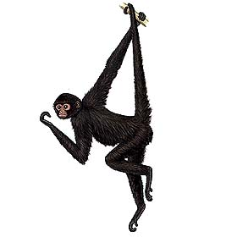
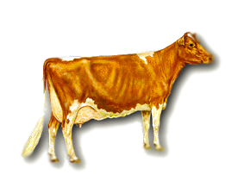
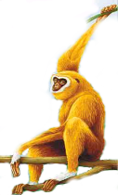
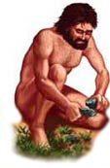
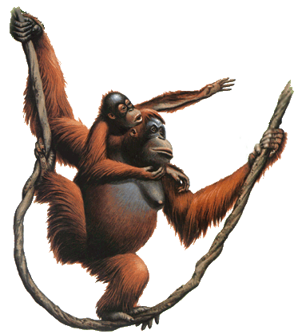
Slide based on one by Eamonn Keogh
There is only one dataset that can be perfectly clustered using a hierarchy…
(Bovine:0.69395, (Spider Monkey 0.390, (Gibbon:0.36079,(Orang:0.33636,(Gorilla:0.17147,(Chimp:0.19268, Human:0.11927):0.08386):0.06124):0.15057):0.54939);

Slide 37
A demonstration of hierarchical clustering using string edit distance
Slide based on one by Eamonn Keogh
Piotr
Peder
Pyotr
Pedro
Piero
Peter
Peka
Mick
Pietro
Pierre
Petros
Peadar
Miguel
Krystof
Michael
Michalis
Crisdean
Cristovao
Christoph
Cristobal
Kristoffer
Christophe
Cristoforo
Christopher

Slide 38











Slide based on one by Eamonn Keogh
Hierarchal clustering can sometimes show patterns that are meaningless or spurious
The tight grouping of Australia, Anguilla, St. Helena etc is meaningful; all these countries are former UK colonies
However the tight grouping of Niger and India is completely spurious; there is no connection between the two.
South Georgia &
South Sandwich
Islands
Serbia &
Montenegro
(Yugoslavia)
AUSTRALIA
St. Helena &
Dependencies
ANGUILLA
U.K.
FRANCE
NIGER
INDIA
IRELAND
BRAZIL

Slide 39
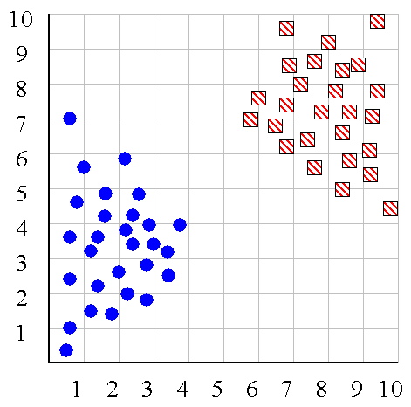
Slide based on one by Eamonn Keogh
We can look at the dendrogram to determine the “correct” number of clusters.
Notes:
In this case, the two highly separated subtrees are highly suggestive of two clusters. (Things are rarely this clear cut, unfortunately)

Slide 40
Slide based on one by Eamonn Keogh
One potential use of a dendrogram: detecting outliers
The single isolated branch is suggestive of a data point that is very different to all others
Outlier

Slide 41
Hierarchical Clustering
Slide based on one by Eamonn Keogh
The number of dendrograms with n leafs = (2n -3)!/[(2^{(n -2)}) (n -2)!]
Number Number of Possible
of Leafs Dendrograms
2 1
3 3
4 15
5 105
... …
34,459,425
Since we cannot test all possible trees we will have to heuristic search of all possible trees. We could do this..
Bottom-Up (agglomerative): Starting with each item in its own cluster, find the best pair to merge into a new cluster. Repeat until all clusters are fused together.
Top-Down (divisive): Starting with all the data in a single cluster, consider every possible way to divide the cluster into two. Choose the best division and recursively operate on both sides.

Slide 42


Slide based on one by Eamonn Keogh
We begin with a distance matrix which contains the distances between every pair of objects in our database.
0
8
8
7
7
0
2
4
4
D( , ) = 8
D( , ) = 1
0
3
3
0
1
0

Slide 43
Bottom-Up (agglomerative): Starting with each item in its own cluster, find the best pair to merge into a new cluster. Repeat until all clusters are fused together.
This slide and next 4 based on slides by Eamonn Keogh
Consider all possible merges…
Choose the best
…

Slide 44
Bottom-Up (agglomerative): Starting with each item in its own cluster, find the best pair to merge into a new cluster. Repeat until all clusters are fused together.
Consider all possible merges…
Choose the best
…
Consider all possible merges…
Choose the best
…

Slide 45
Bottom-Up (agglomerative): Starting with each item in its own cluster, find the best pair to merge into a new cluster. Repeat until all clusters are fused together.
Consider all possible merges…
Choose the best
…
Consider all possible merges…
Choose the best
…
Consider all possible merges…
Choose the best
…

Slide 46
Bottom-Up (agglomerative): Starting with each item in its own cluster, find the best pair to merge into a new cluster. Repeat until all clusters are fused together.
Consider all possible merges…
Choose the best
…
Consider all possible merges…
Choose the best
…
Consider all possible merges…
Choose the best
…

Slide 47
Slide based on one by Eamonn Keogh
We know how to measure the distance between two objects, but defining the distance between an object and a cluster, or defining the distance between two clusters is non obvious.
Single linkage (nearest neighbor): In this method the distance between two clusters is determined by the distance of the two closest objects (nearest neighbors) in the different clusters.
Complete linkage (furthest neighbor): In this method, the distances between clusters are determined by the greatest distance between any two objects in the different clusters (i.e., by the "furthest neighbors").
Group average linkage: In this method, the distance between two clusters is calculated as the average distance between all pairs of objects in the two different clusters.

Slide 48
Slide based on one by Eamonn Keogh
Single linkage
Average linkage

Slide 49
Slide based on one by Eamonn Keogh
Hierarchal Clustering Methods Summary
No need to specify the number of clusters in advance
Hierarchal nature maps nicely onto human intuition for some domains
They do not scale well: time complexity of at least O(n²), where n is the number of total objects
Like any heuristic search algorithms, local optima are a problem
Interpretation of results is (very) subjective

Slide 50







Slide based on one by Eamonn Keogh
Partitional Clustering
Nonhierarchical, each instance is placed in exactly one of K non-overlapping clusters.
Since only one set of clusters is output, the user normally has to input the desired number of clusters K.

Slide 51
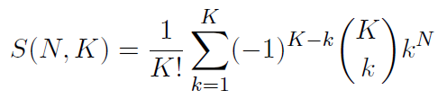
Combinatorial Approach
In how many ways can we assign K labels to N observations?
For each such possibility, we can compute a cost. Pick up the assignment with best cost.
Formidable number of possible assignments:

Slide 52
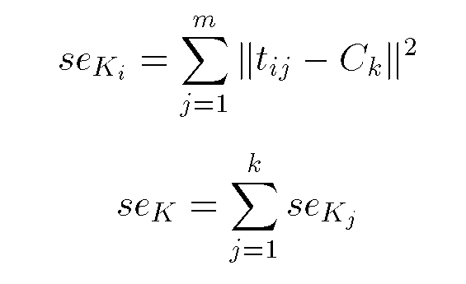
Squared Error
Slide based on one by Eamonn Keogh
10
9
8
7
6
5
4
3
2
1
1
2
3
4
5
6
7
8
9
10
Objective Function

Slide 53
Slide based on one by Eamonn Keogh
Partition Algorithm 1: k-means
1. Decide on a value for k.
2. Initialize the k cluster centers (randomly, if necessary).
3. Decide the class memberships of the N objects by assigning them to the nearest cluster center.
4. Re-estimate the k cluster centers, by assuming the memberships found above are correct.
5. If none of the N objects changed membership in the last iteration, exit. Otherwise goto 3.

Slide 54
K-means Clustering: Step 1
Algorithm: k-means, Distance Metric: Euclidean Distance
5
4
k₁
3
k₂
2
1
k₃
0
0
1
2
3
4
5
Slide based on one by Eamonn Keogh

Slide 55
K-means Clustering: Step 2
Algorithm: k-means, Distance Metric: Euclidean Distance
5
4
k₁
3
k₂
2
1
k₃
0
0
1
2
3
4
5
Slide based on one by Eamonn Keogh

Slide 56
K-means Clustering: Step 3
Algorithm: k-means, Distance Metric: Euclidean Distance
5
4
k₁
3
2
k₃
k₂
1
0
0
1
2
3
4
5
Slide based on one by Eamonn Keogh

Slide 57
K-means Clustering: Step 4
Algorithm: k-means, Distance Metric: Euclidean Distance
5
4
k₁
3
2
k₃
k₂
1
0
0
1
2
3
4
5
Slide based on one by Eamonn Keogh

Slide 58
K-means Clustering: Step 5
Algorithm: k-means, Distance Metric: Euclidean Distance
k₁
k₂
k₃
Slide based on one by Eamonn Keogh

Slide 59
Comments on k-Means
Strengths
  Relatively efficient: O(tkn), where n is # objects, k is # clusters, and t is # iterations. Normally, k, t << n.
  Often terminates at a local optimum.
Weakness
  Applicable only when mean is defined, then what about categorical data?
  Need to specify k, the number of clusters, in advance
  Unable to handle noisy data and outliers
  Not suitable to discover clusters with non-convex shapes
Slide based on one by Eamonn Keogh

Slide 60
How do we measure similarity?
Peter
Piotr
0.23
3
342.7
Slide based on one by Eamonn Keogh

Slide 61
A generic technique for measuring similarity
To measure the similarity between two objects, transform one into the other, and measure how much effort it took. The measure of effort becomes the distance measure.
The distance between Patty and Selma:
Change dress color, 1 point
Change earring shape, 1 point
Change hair part, 1 point
D(Patty,Selma) = 3
The distance between Marge and Selma:
Change dress color, 1 point
Add earrings, 1 point
Decrease height, 1 point
Take up smoking, 1 point
Lose weight, 1 point
D(Marge,Selma) = 5
This is called the “edit distance” or the “transformation distance”
Slide based on one by Eamonn Keogh

Slide 62
Edit Distance Example
How similar are the names “Peter” and “Piotr”?
Assume the following cost function Substitution 1 Unit
Insertion 1 Unit
Deletion 1 Unit
D(Peter,Piotr) is 3
It is possible to transform any string Q into string C, using only Substitution, Insertion and Deletion.
Assume that each of these operators has a cost associated with it.
The similarity between two strings can be defined as the cost of the cheapest transformation from Q to C.
Note that for now we have ignored the issue of how we can find this cheapest transformation
Peter
Piter
Pioter
Piotr
Substitution (i for e)
Insertion (o)
Piotr
Pyotr
Pedro
Piero
Peter
Petros
Pietro
Pierre
Deletion (e)
Slide based on one by Eamonn Keogh

Slide 63
What distance metric did k-means use?
What assumptions is it making about the data?
Notes:
Assuming all features are important
normalized

Slide 64
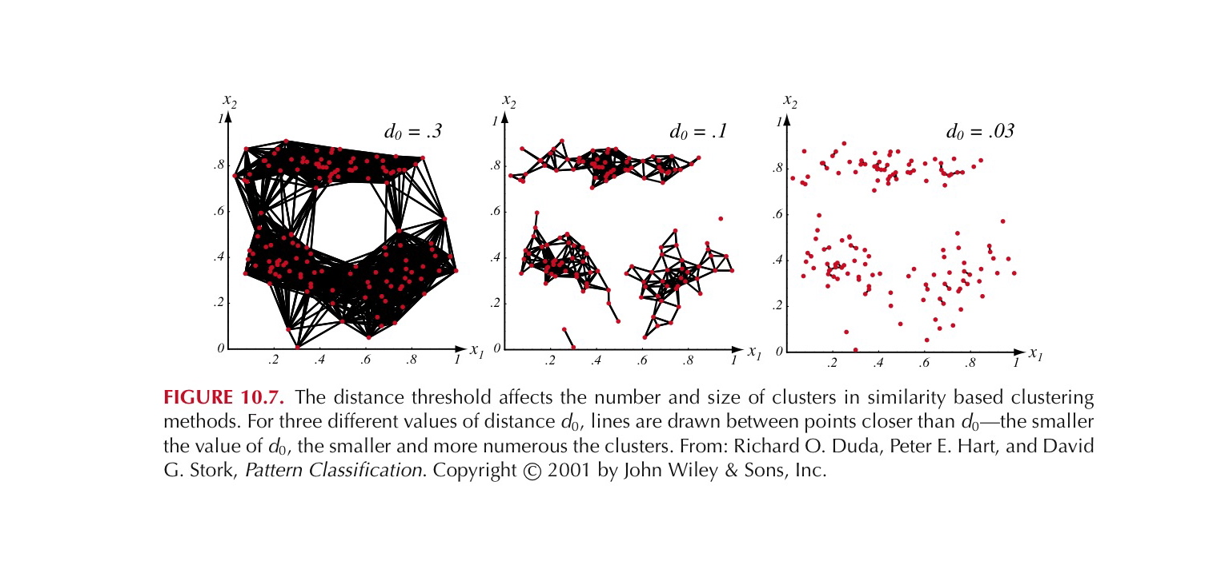
Partition Algorithm 2: Using a Euclidean Distance Threshold to Define Clusters
Notes:
If we say that two examples belong to the same cluster if the Euclidean distance bwtween them is less than some distance d_o. It is immediately obvious that the choice of d_o is
critical. If d_o is large all of the samples will be assigned to one cluster, if d_o is very small each sample will form an isolated singleton cluster. To obtain natural clusters, d_o will have to be greater than the typical within cluster distances and less than the typical between cluster distances.

Slide 65
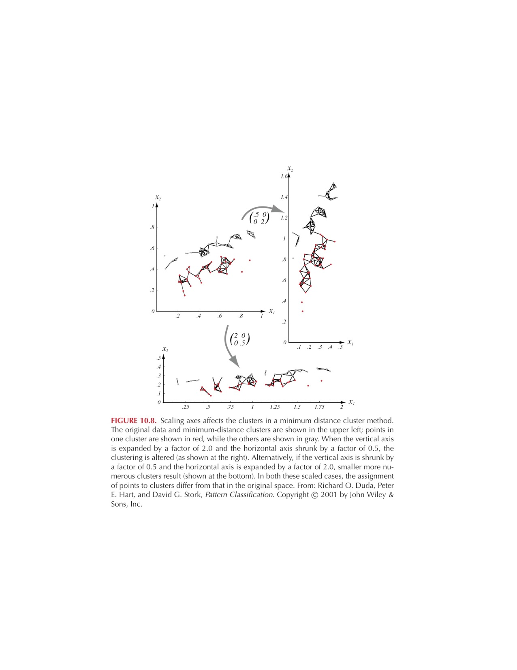
But should we use Euclidean Distance?
Good if data is isotropic and spread evenly along all directions
Not invariant to linear transformations, or any transformation
that distorts distance relationships
Notes:
Isotropic means uniform in all directions
Figure shows that simple scaling of the coordinate axes can result in a different grouping of the data into clusters.
One way to achieve invariance is to normalize the data before clustering!!!

Slide 66
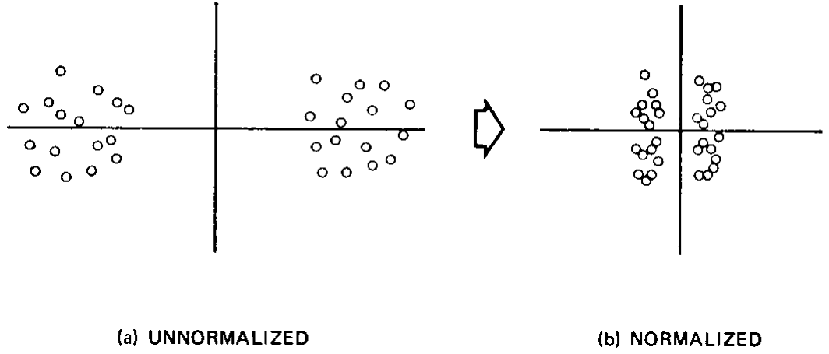
Is normalization desirable?

Slide 67
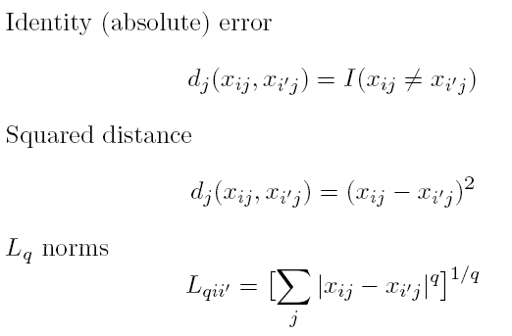
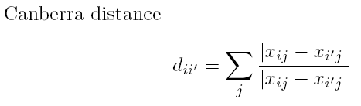
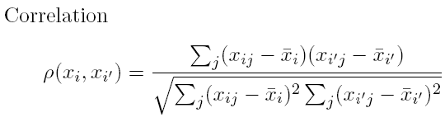
Distances: Quantitative Variables
Data point:
Some examples

Slide 68
Distances: Ordinal and Categorical Variables
Ordinal variables can be forced to lie within (0, 1) and then a quantitative metric can be applied:
For categorical variables, distances must be specified by user between each pair of categories.

Slide 69
Combining Distances
Often weighted sum is used:

Slide 70
What is a good clustering?

